Slide 1

Reception
Moving in to Reception September 2020

Slide 2

Welcome
Hello!
We are delighted
that you have
chosen our school
for your children
and look forward
to a busy and
successful year of
learning.

Slide 3
EARLY YEARS FOUNDATION STAGE
Reception is part of the Early Years Foundation Stage
https://www.foundationyears.org.uk/files/2017/03/EYFS_STATUTORY_FRAMEWORK_2017.pdf
◆ 7 areas of learning
◆ 3 PRIME AREAS – Communication & Language,
Personal, Social and Emotional development and
Physical Development
◆ 4 SPECIFIC AREAS – Mathematics, Literacy, Knowledge
& Understanding of the World, Expressive Art & Design
◆ Working towards achieving a GOOD LEVEL OF
DEVELOPMENT in the Early Learning Goals next
June/July

Slide 4
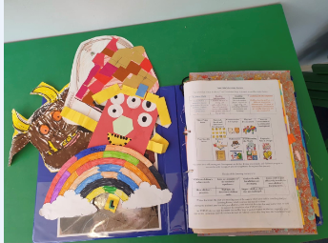
HOW WE LEARN AND GROW
◆ Learning in Early Years is through independent play and some more structured adult-led teaching activities.
◆ We observe your child, make assessments and plan activities and continuous provision based on what we have seen and what each child needs.
◆ A learning journal is kept which records each child’s progress and key learning achievements through ‘Evidence Me’ one of our assessment tools.

Slide 5
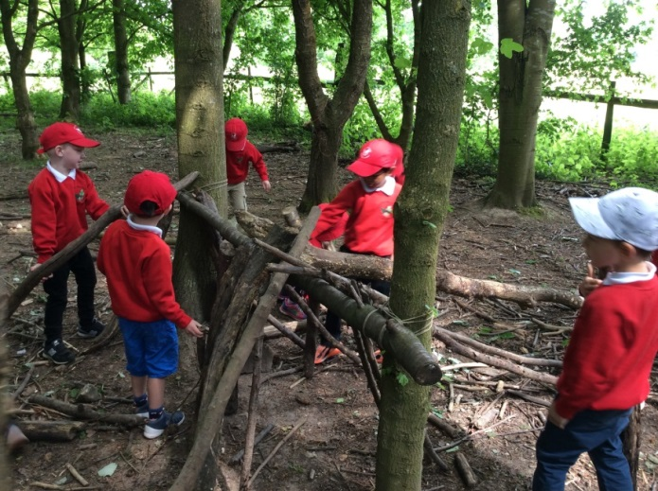
OUTDOOR LEARNING
◆ The outdoor area is a classroom.
◆ We will learn and explore outdoors every day.
◆ Outdoor learning improves wellbeing and health and enables curiosity and exploration.
◆ Children need to be prepared for whatever the weather is like. We will be outside in the sunshine, wind, rain, snow! All weather learners.
◆ Please provide your child with wellies, waterproofs or a puddle suit that stay in school all year round.

Slide 6
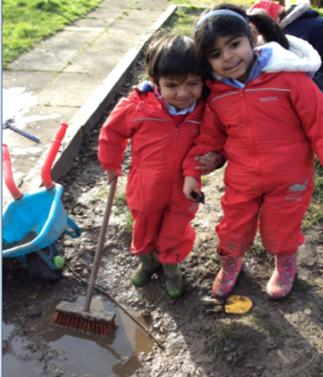
MESSY PLAY
◆ We encourage messy play and independent
exploration as part of the learning process.
◆ One of the reasons for uniform is so that own clothes
are not ruined.
◆ Aprons do not solve everything and children will still
come home covered in paint, gloop, mud, water
and all manner of other exciting things!
◆ Please remember that MESS is part of learning and
we encourage our children to explore and
investigate.

Slide 7
TRANSITION
◆ The world has changed rapidly in the last few months. The transition
activities that we had planned unfortunately could not be delivered.
◆ We will follow all advice given to us to keep children and adults safe and we will keep you updated on any changes that may occur.
◆ Staff will be very focused on the welfare of each child and we will have a very gentle start to Reception. We understand children may be anxious and will work hard to make them feel safe, secure and happy.
◆ We have a fully integrated recovery PSHE program called JIGSAW that will address any issues that require repair.
◆ We will spend time talking to children to understand their anxieties and lots of time developing and building relationships so that children feel happy and safe. Happy safe children have better outcomes and learn more effectively.

Slide 8
SCHOOL DAY
◆ Start of day 8:55am. In September we will have a staggered start to the day details will be communicated by email.
◆ Lunchtime 12.00 pm-1.00pm
◆ Home time 3.10pm
◆ Punctuality and attendance are monitored
closely!
◆ Breakfast and After school club BASC are available.

Slide 9
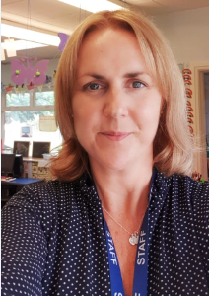
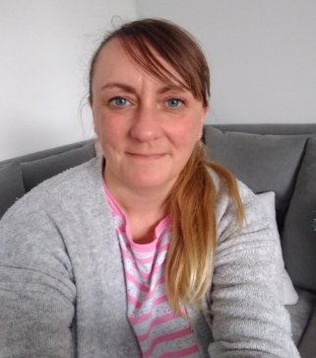

STAFF
Mrs Jones
Mrs West
Early Years Lead
PSHE Lead
Mental Health & Well being
Circle of Security Facilitator
Mrs Durbin
Teaching Assistant Teaching Assistant

Slide 10
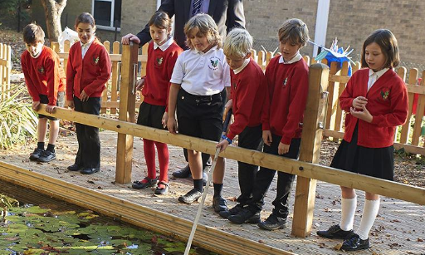
UNIFORM
◆ Please remember to put names inside all items of clothing – coats etc. We cannot spend time looking for clothing that is not labelled.
◆ Children will need a PE kit in house colours in the autumn term in a PE bag that has their name on.
◆ They will need a school bag in their house colour and a water bottle.
◆ Wellies waterproofs and a warm coat in the winter are essential ; summer hats and applied sun protection in the sunny weather.
https://www.littlechalfontprimaryschool.co.uk/uniform-1/

Slide 11
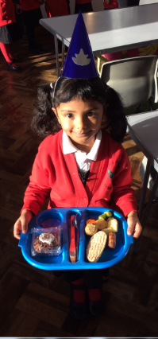
SCHOOL LUNCHES
◆ All children get a free school meal in Reception so
there is no need to bring their own packed lunch however having a lunch that is familiar from home can help those who find lunchtimes a little more challenging.
ABSOLUTELY NO NUTS ARE ALLOWED IN ANY PRODUCTS OR IN SCHOOL. PLEASE BE SENSITIVE TO OTHER CHILDREN’S SAFETY AND NEEDS
◆ This can be a big transition.
◆ Playtime at lunch will be on the Reception playground. They will mix with Year 1 children as well.
◆ Please make sure you have filled and returned the
forms about free school meals and ordered your child’s meals. These will be packed lunches only in September.

Slide 12
PARENT PAY
◆ School uses parent pay to pay for trips and meals etc.
◆ You will be able to make all payments that you
need to directly into school.
◆ Ask if you are unsure or do not have the details of your account in the office.

Slide 13
HOMEWORK
◆ Weekly newsletters will be sent home with key letter sounds that will be our weekly focus and when ready the children will bring home reading and other tasks.
◆ Talking, sharing and engaging with your child is the best homework ever! https://earlyyears.buckscc.gov.uk/eyfs-learning-and-development/eyfs-areas-of-learning/communication-and-language/
◆ Children once settled will visit the school library and bring home a book each week.
◆ Reading books will be sent home 2/3 times a week depending on the individual child when they are reading ready.
◆ There will be a Phonics parent session in the Autumn term to share our teaching methods with parents.

Slide 14

PHONICS
◆ We use Phonics Bugs to learn phonemes and graphemes building on from Letters and Sounds used in our Nursery.
◆ We develop writing and letter formation as children can blend sounds together.
◆ Phonics sessions will be held daily after the first half term .
◆ Please use PURE LETTER SOUNDS with your child not letter names!
◆ Please only use capitals for the first letter of names and places when modelling writing for your child, everything else should be lower case.

Slide 15
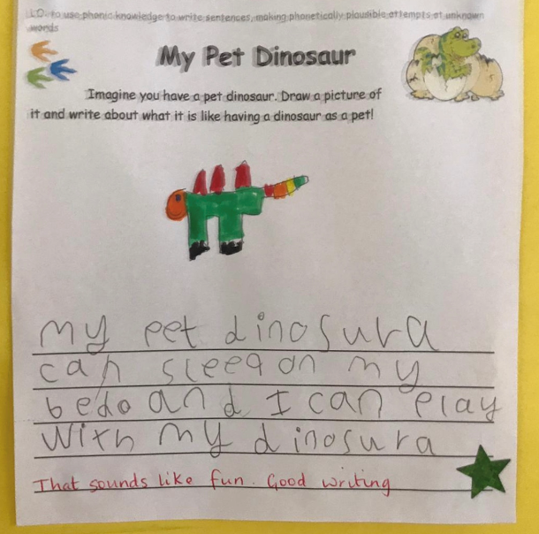
READING AND WRITING
.
◆ Communication and language is
vital!
◆ Please spend time talking,
listening and playing with your
child. YOU make the difference!
◆ The early years of life are recognised as the most intensive period for acquiring speech and language skills.
◆ These early years need to be filled with experiences of sound and language.
◆ Only then can your child move on to reading and writing

Slide 16

LETTER FORMATION

Slide 17
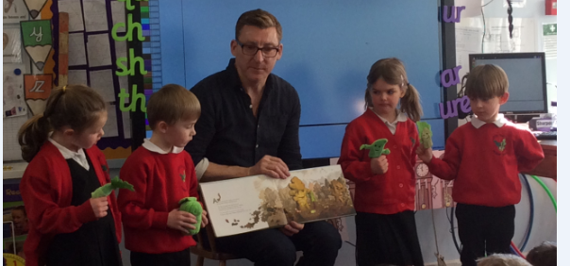
TALK FOR WRITING
One of our writing approaches
is called talk 4 writing
https://www.talk4writing.com/
Children learn to imitate a
story, rhyme or non-fiction
text. We use gestures to act
out a story.
Children then innovate the
story and change objects,
characters or settings.
Children then develop
internal vocabulary and
writing features and use
these to invent their own
stories and texts.

Slide 18

MATHS MASTERY
◆ To teach mathematics we use a mastery approach in Reception class.
◆ Mastery maths approach is all about DEPTH of knowledge.
◆ We will learn about numbers every week and use that to drive our teaching and learning through concrete pictorial and abstract activities.
https://www.littlechalfontprimaryschool.co.uk/maths-mastery/
.

Slide 19
ASSESSMENT
◆ We do a Baseline in September – this tells us what your
children can do and where they need support.
◆ We assess your child’s progress and areas for development against development matters.
https://www.foundationyears.org.uk/files/2012/03/Development-Matters-FINAL-PRINT-AMENDED.pdf
◆ We share assessments with you on Parent Evenings, through
learning journals and Evidence Me.
◆ We are working towards a GOOD LEVEL OF
DEVELOPMENT in their Early Learning Goals in July.
◆ Children will be, ‘Emerging, Expected or Exceeded,’ in
July in these Early Learning Goals!

Slide 20
BEHAVIOUR
◆ READY
◆ RESPECTFUL
◆ RESILIENT
https://primarysite-prod-sorted.s3.amazonaws.com/littlechalfontprimaryschoolamersham/UploadedDocument/8c520af18bfd4eebae352db479dd3499/behaviour-anti-bullying-nov-2017.pdf

Slide 21
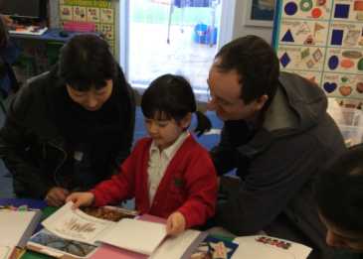

PARENTAL INVOLVEMENT
◆ As much as possible please!
◆ Newsletters
◆ Website
◆ Reports
◆ Parent review meetings
◆ Google classroom /https://www.littlechalfontprimaryschool.co.uk/remote-learning-2
◆ Stay and play sessions/Reading/Cooking/Sewing help
◆ Parent Information sessions
◆ Circle of Security Parenting Program
https://www.circleofsecurityinternational.com/resources-for-parents/

Slide 22
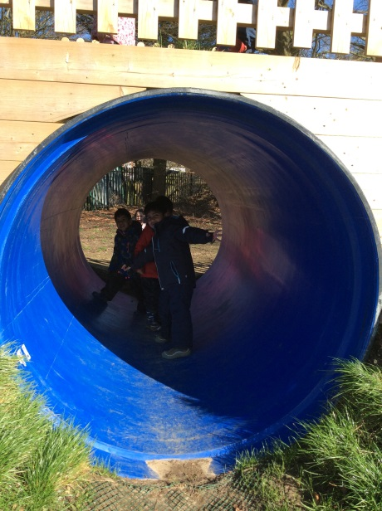
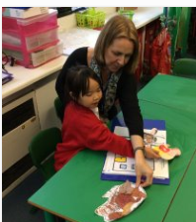
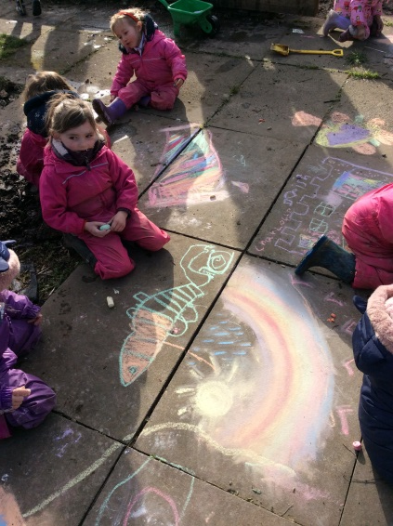
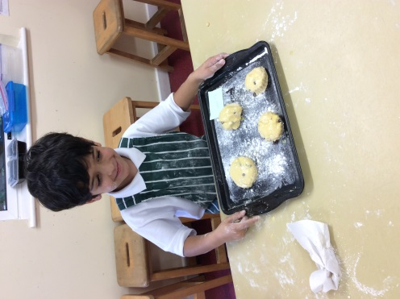
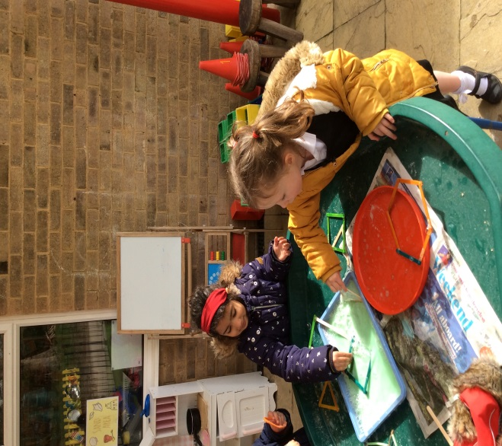
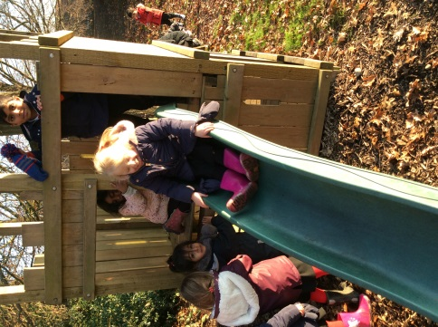
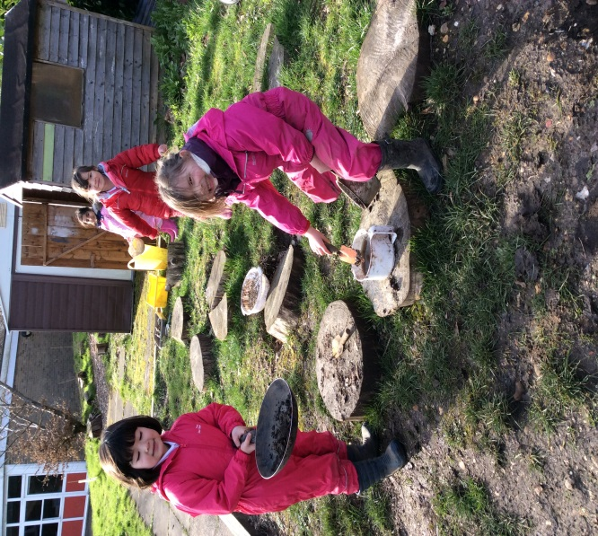
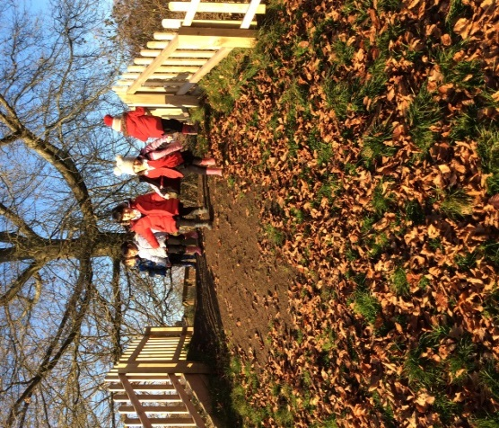

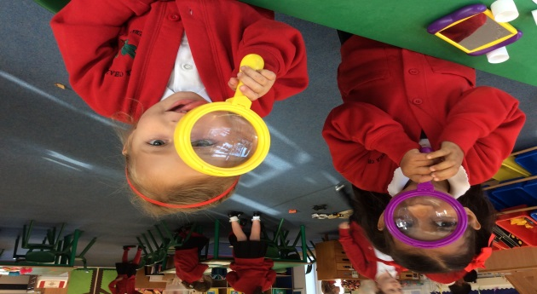
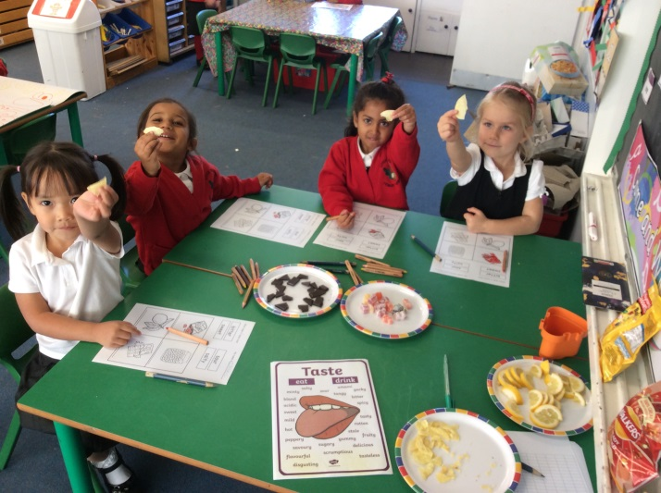
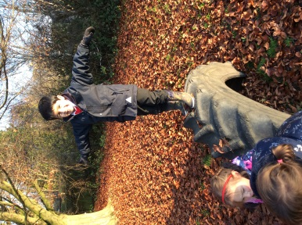
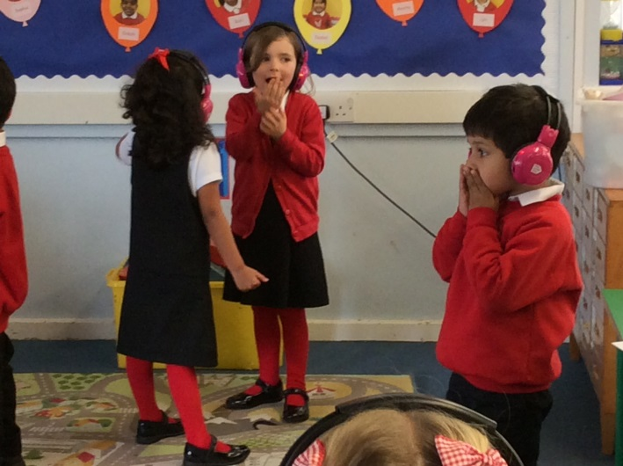
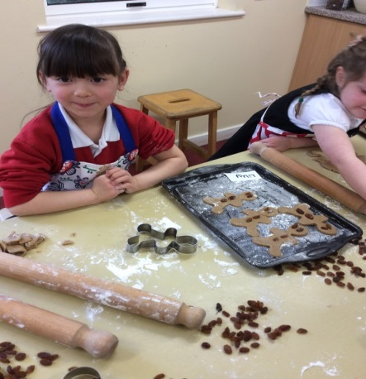

Slide 23
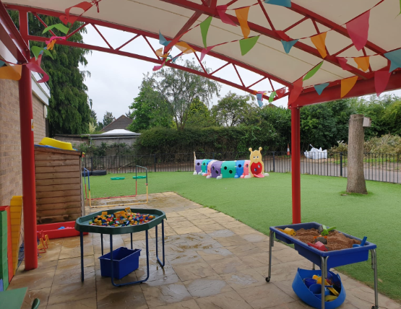
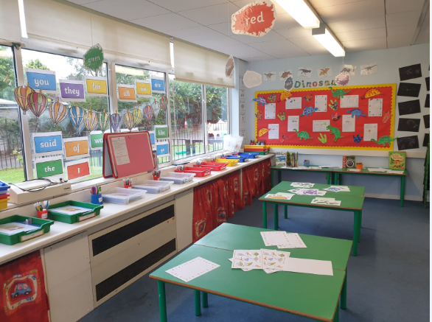
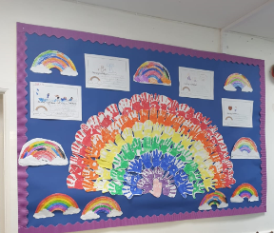
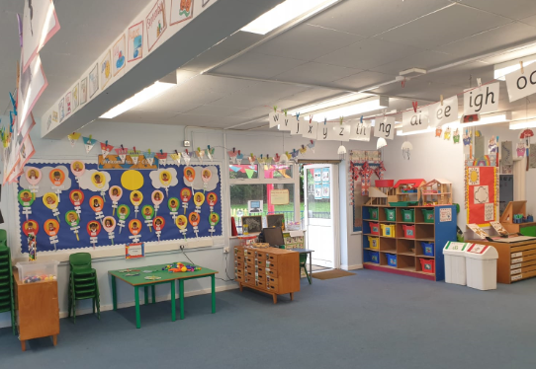
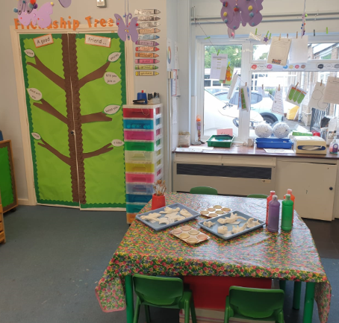
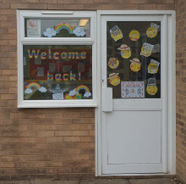
OUR CLASSROOM

Slide 24

PARTNERSHIP
We are looking forward to working with you as your child takes this big step starting school!

