Slide 1
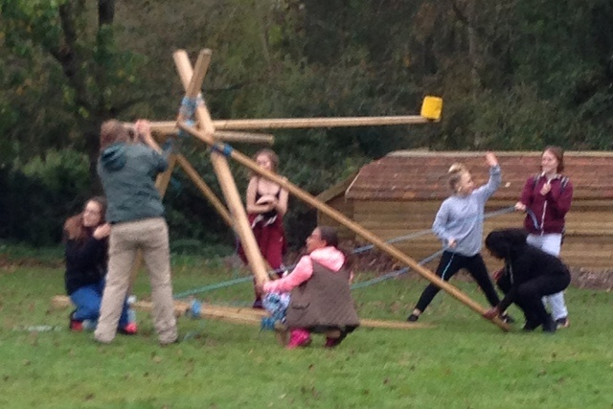
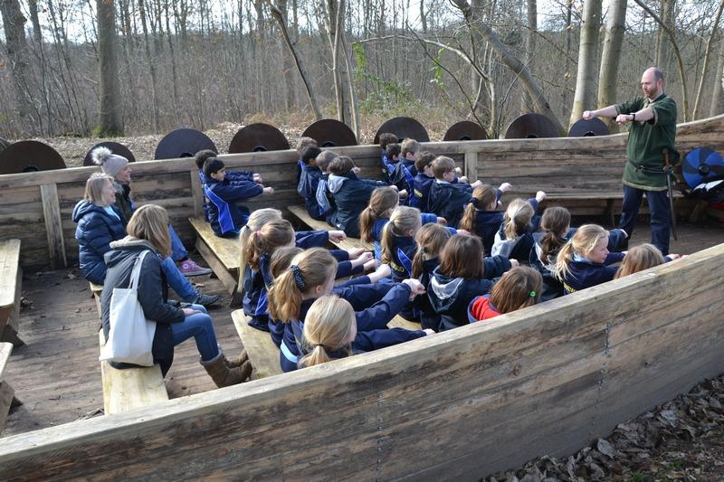
Ufton Court
25th-27th September 2019

Slide 2
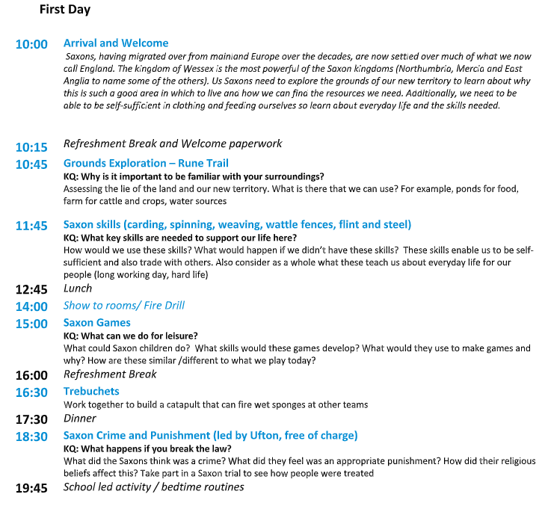
Itinerary: Day 1

Slide 3
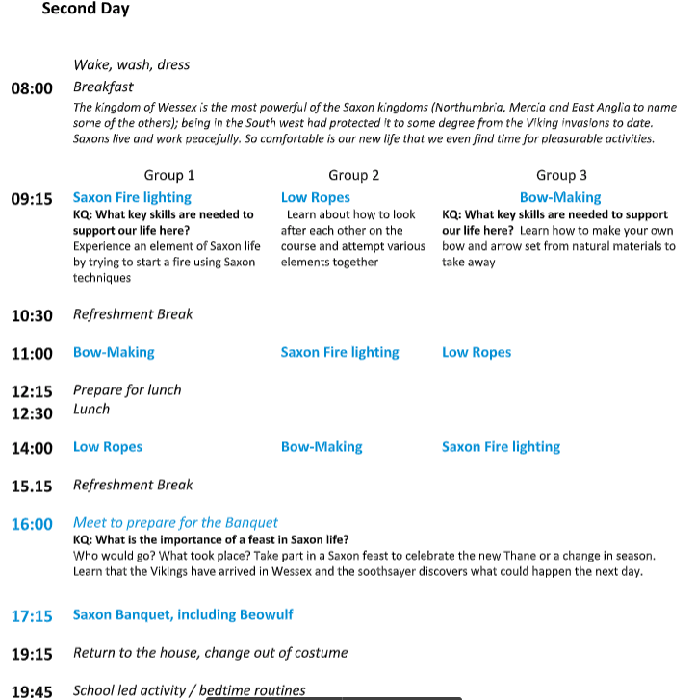
Itinerary: Day 2

Slide 4
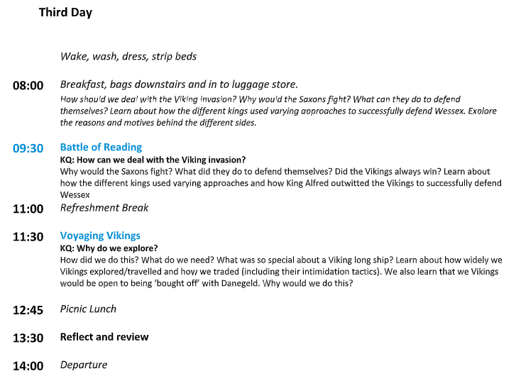
Itinerary: Day 3

Slide 5
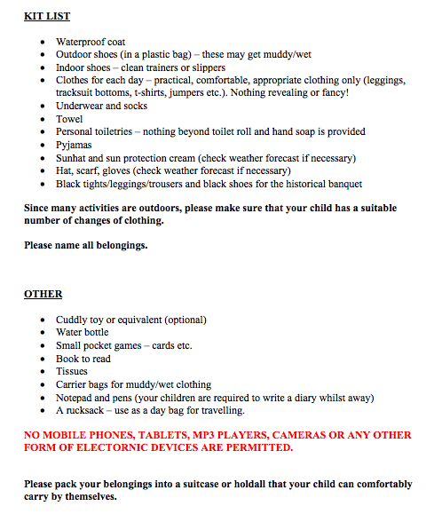
Kit List
Indoor/ outdoor footwear policy
Raincoat
Warm clothes

Slide 6
Electronics
Please do not bring any electronics, including mobile phones.
If we find the children with electronics they will be confiscated for the rest of the trip.
We take no responsibility for any damage that happens to electronics on this trip.

Slide 7
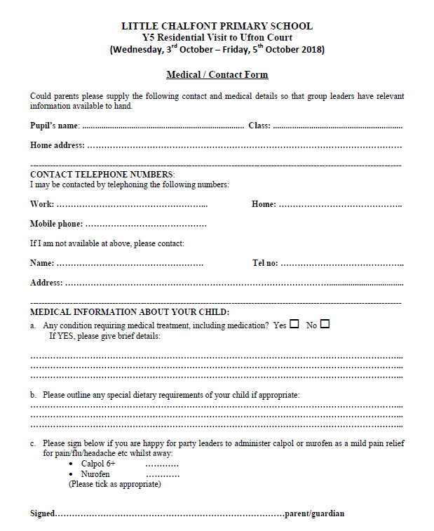
Medical
MEDICINES AND MEDICATION:
You have all completed the medical form last term. If there are any changes since you completed this form, please let me know ASAP.
Please give any medicines to Miss Macmillan on the Wednesday morning we leave, including inhalers.
ALL MEDICINES MUST BE CLEARLY NAMED AND THE DOSAGE CLEARLY STATED.

Slide 8
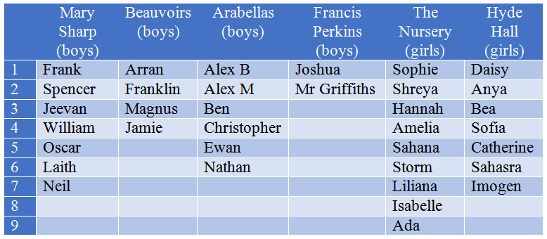
Sleeping Arrangements

Slide 9
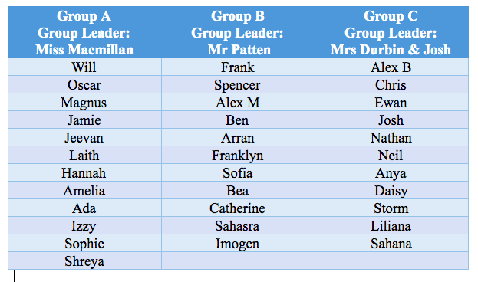
Activity Groups

Slide 10
Money
No pocket money is needed – please do not bring any.
The children will be allocated £2 from the money that has been paid for their trip to buy something from the shop.
They will choose this in advance.

Slide 11
Diary Entry
As part of their English work this term, your children will be writing a diary entry based on their time at Ufton Court.
Please can they bring a notepad and pen with them to help them with this exercise.

Slide 12
Food & Allergies
All meals are provided. This includes breakfast, lunch and supper.
No sweets, chocolate or other snacks are permitted.
Allergies: Please let me know ASAP of any allergies so that I can send accurate information to catering at Ufton Court.
Vegetarian: Unless stated otherwise, it will be assumed that the children eat fish.

Slide 13
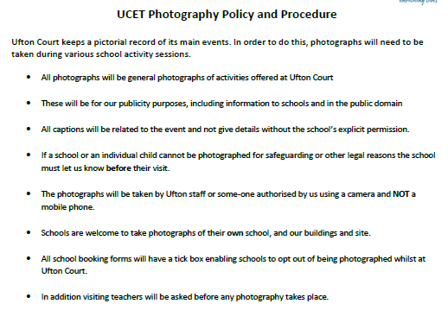
Photography

Slide 14
Behaviour
Our school has an excellent reputation for good behaviour when involved in educational visits.
Please ensure that this is maintained at all times whilst at Ufton Court.
Think of other people in all that you do and we will all enjoy ourselves.
DON’T SPOIL THE VISIT FOR ANY OTHER CHILD OR ADULT.

Slide 15
Any Questions?

