Slide 1


LCPS PTA AGM 2023-24
Tuesday 24th September 2024, 7.30pm - 8.15pm
Please come along and see what your PTA have raised and invested in this year with all your invaluable support!
Join us for a round up from the Chair, Treasurer and Head teacher.
Meet our new committee members and find out how you can help in 2024-25.

Slide 2
Tuesday 24th Sep 2024
7.30pm Welcome and Introduction
7.35pm Chair’s Report
7.45pm Treasurer’s Report
7:50pm Head Teacher’s Report
8.00pm Elections (Committee Members, Officers, Auditor)
8.15pm AOB and Open Questions

Slide 3
Chair’s Report
(all following figures are net profit and awaiting final auditing)

Slide 4
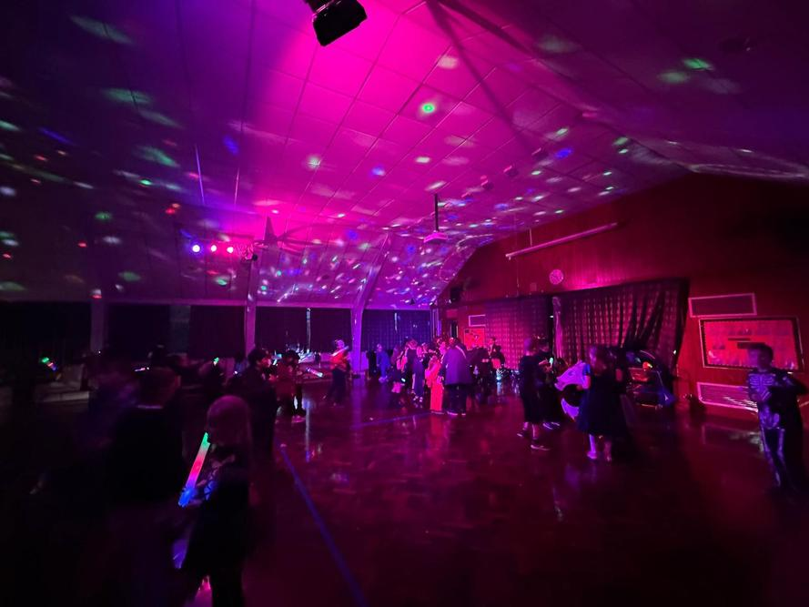
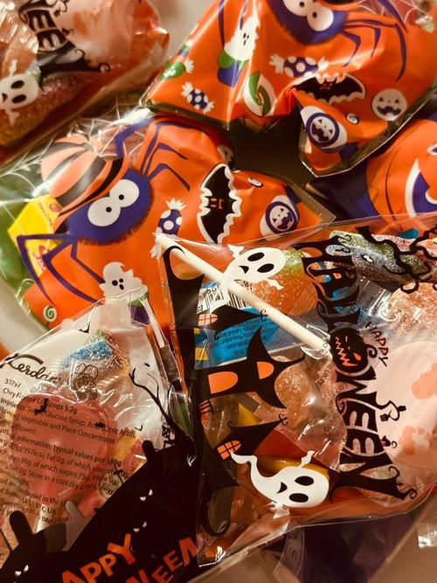
Halloween Disco
Disco after school split for KS 1 for the first hour and KS 2 after.
Parent support provision of disco lights/music.
Cake stall
Tuck stall (lights/gift bags)
Face painting
£926.79
Net of costs

Slide 5
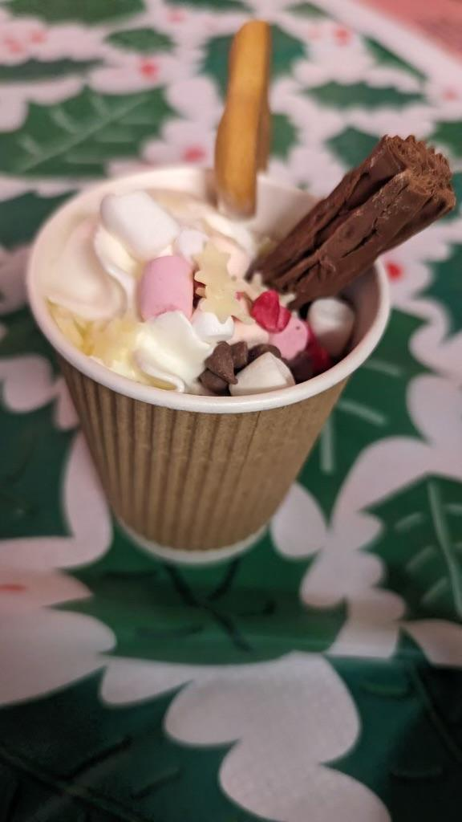
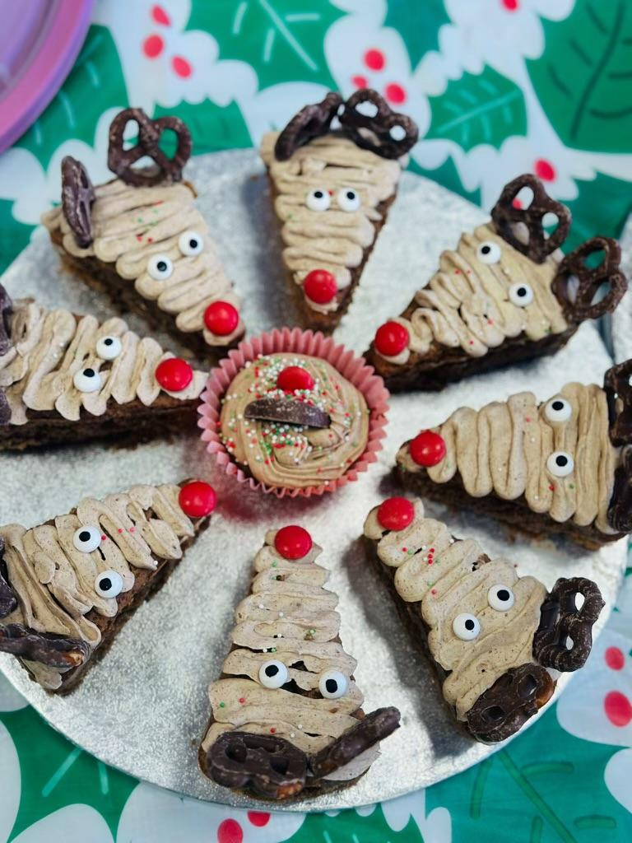
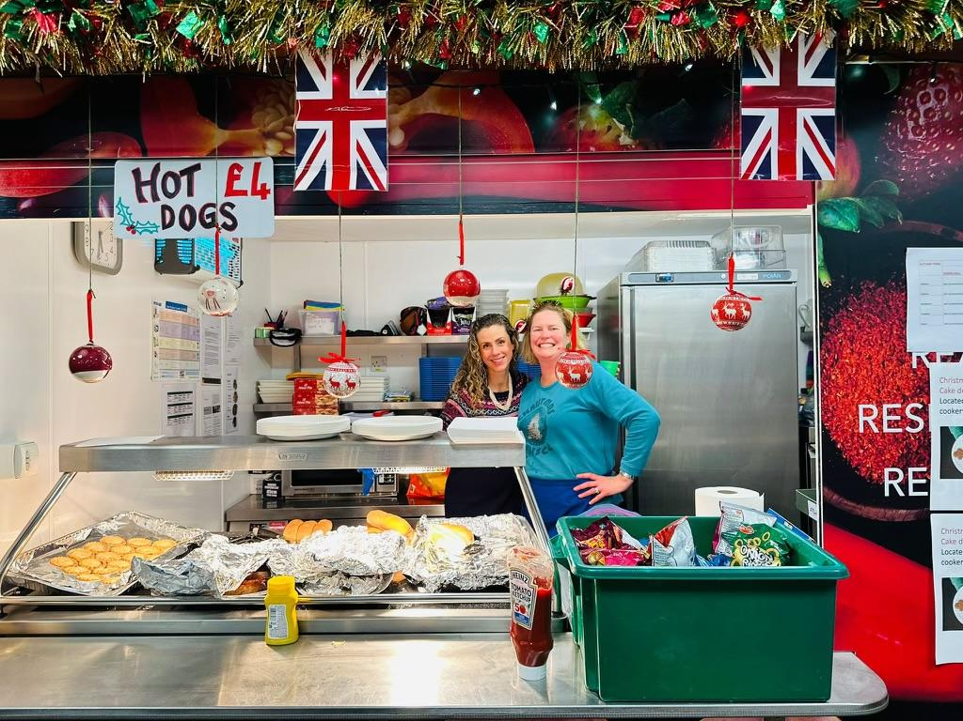
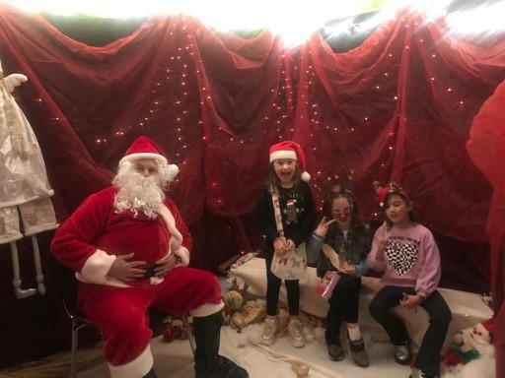
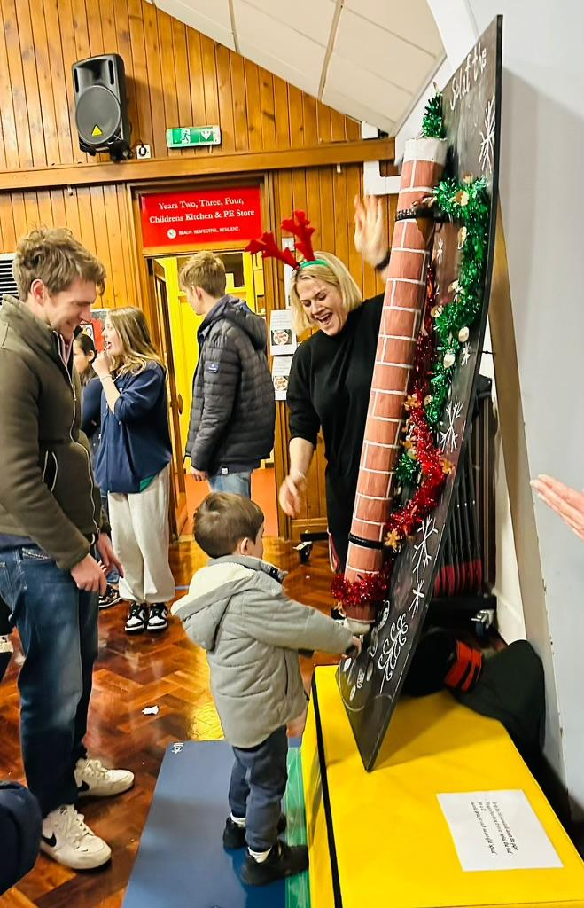
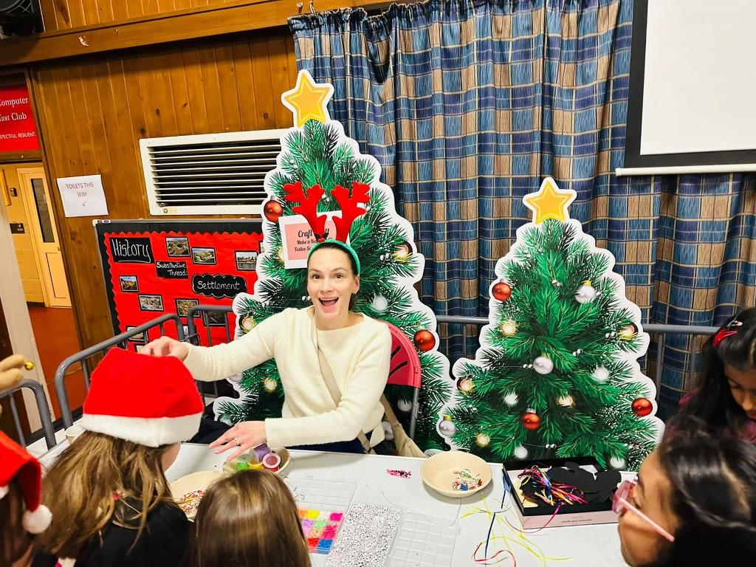
Merry Market Christmas Fayre
Changed the timing to late afternoon
External food supplier “plant based kitchens” & hot dogs
Games, crafts, tombolas, tuck shop, biscuit decorating, cake competition, bar
External market stalls
Santas grotto
£1823
(£1585 in 2022/23)

Slide 6
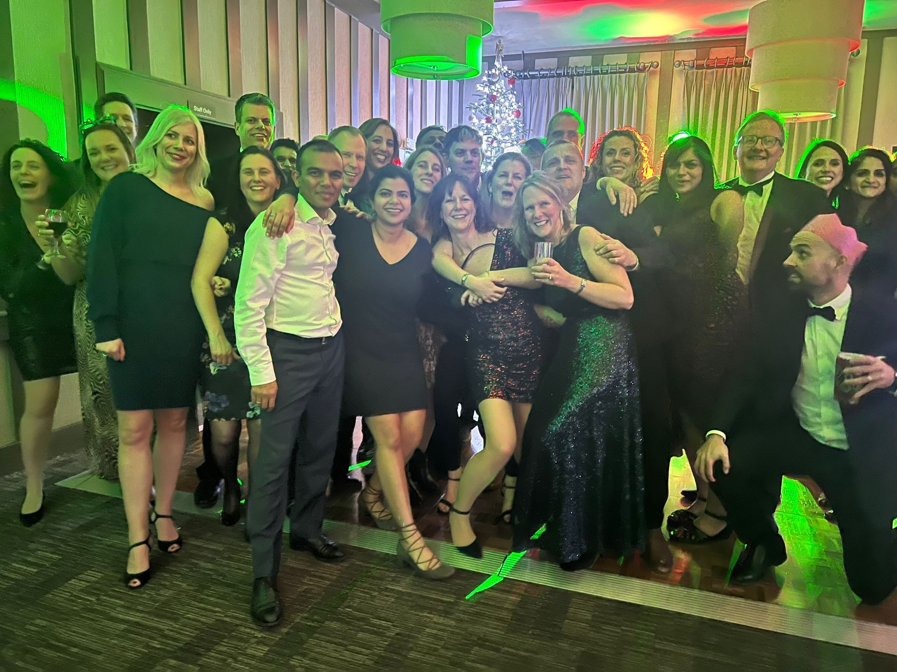
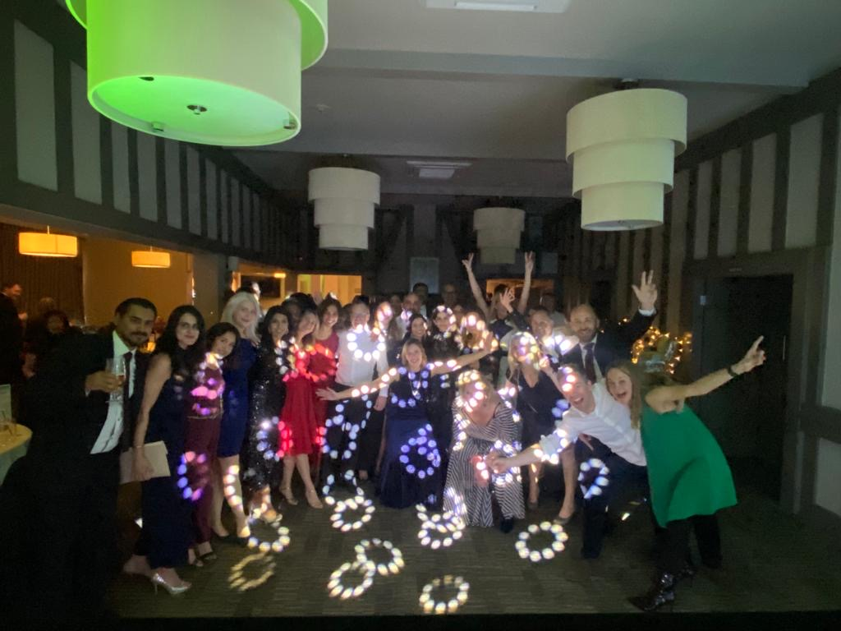
Christmas Dinner Dance
£3664
(£3467 in 2022/23)
Hosted at Harewood Downs Golf Club - 3 course meal
Tickets sold in advance
DJ and disco
Auction of items secured by PTA members and raffle prizes also drawn

Slide 7
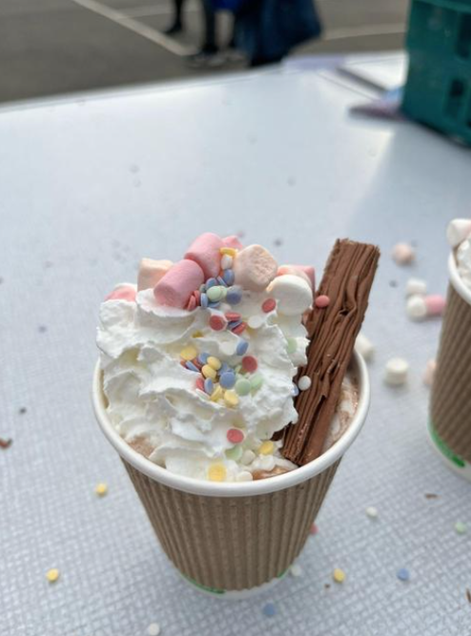
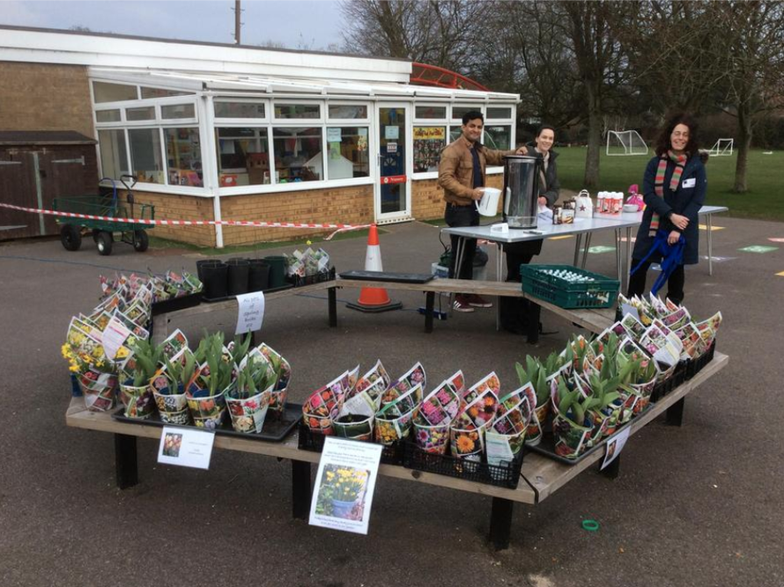
Hot Chocolate & Mother’s Day Sale -
March
Sold hot chocolates with toppings after school in March
Used up surplus hot choc powder and toppings from Xmas fayre
Also sold wrapped Mother’s Day biscuits and plants grown from bulbs in the school garden.
£607
Net of costs

Slide 8

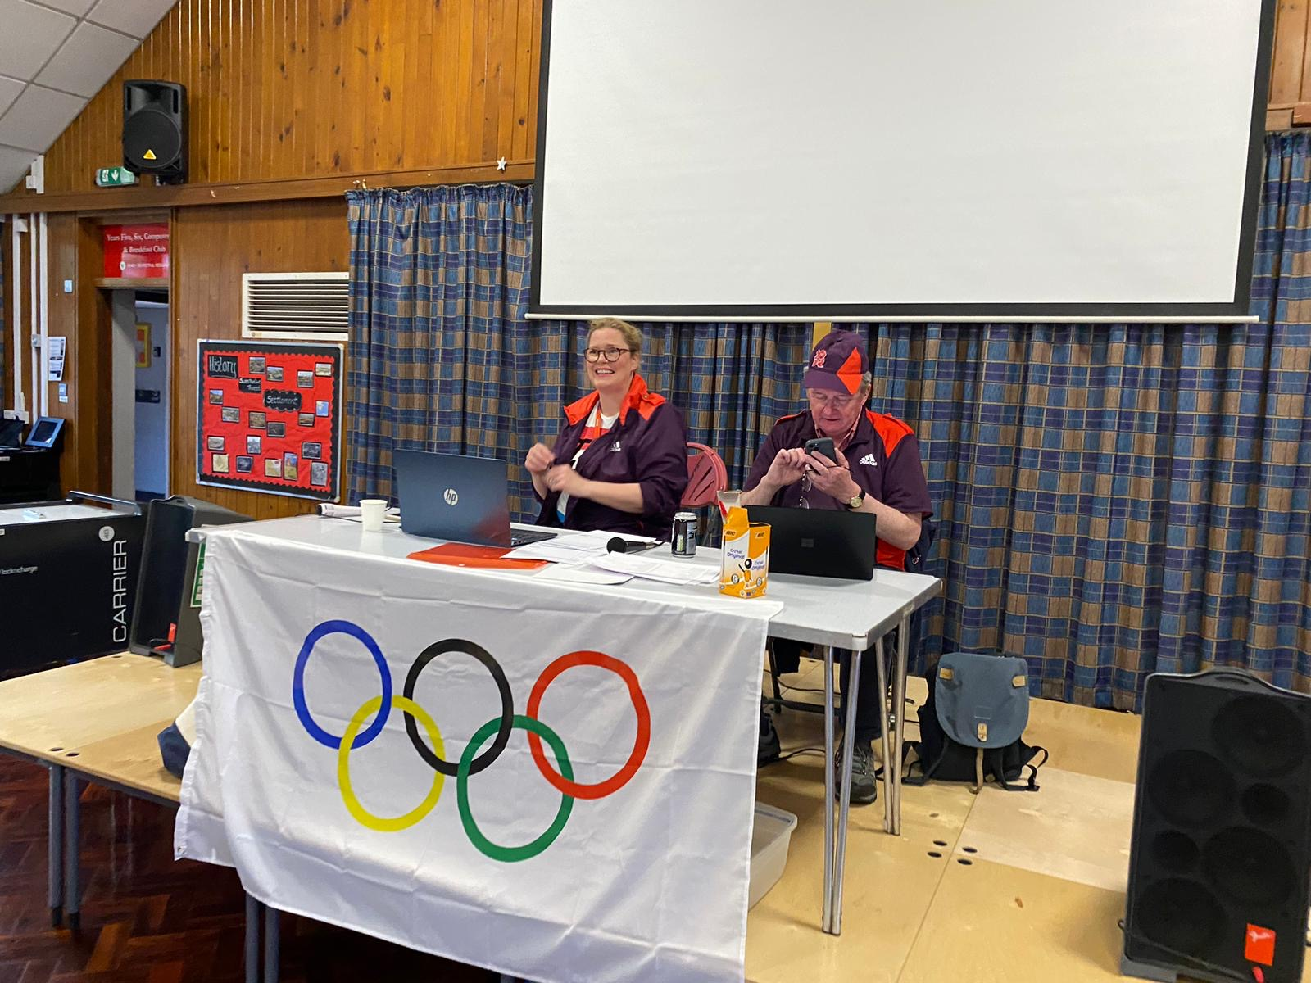
Year of the Olympics
Quiz Night
Quiz designed and delivered by Katherine Punch and Chris Heier.
Tickets were sold in advance
Vege and meat chilli served by PTA members
Pudding auction of homemade goodies
Full bar provided.
£1644
(£1313 in 2022/23)

Slide 9
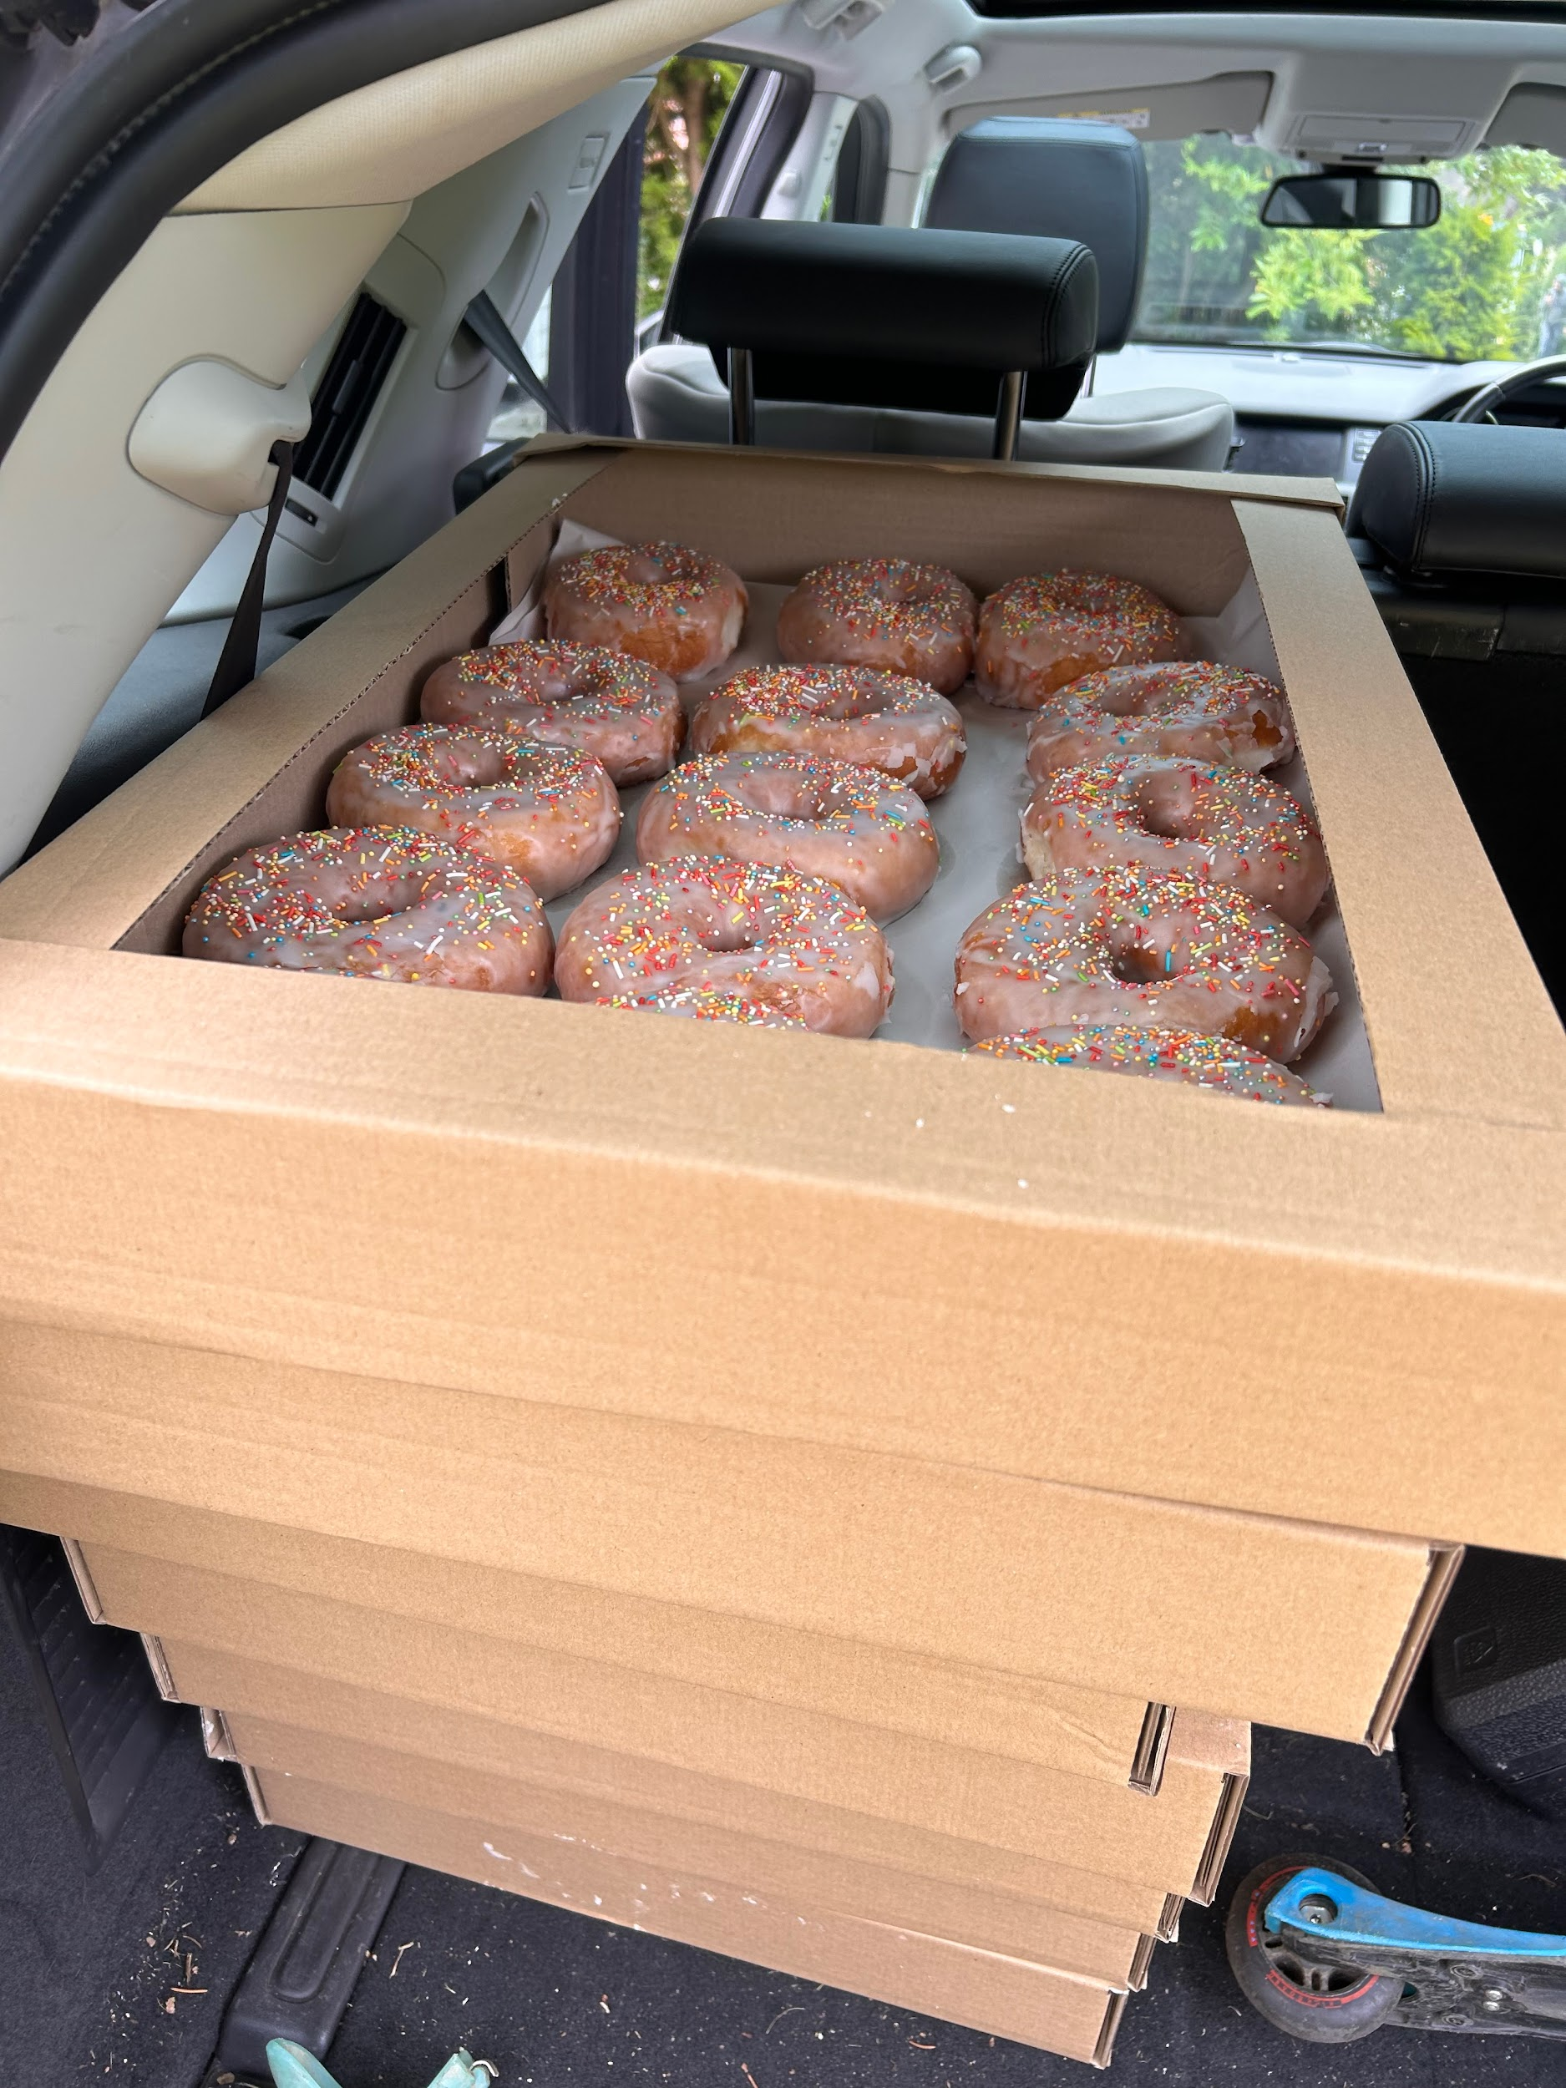
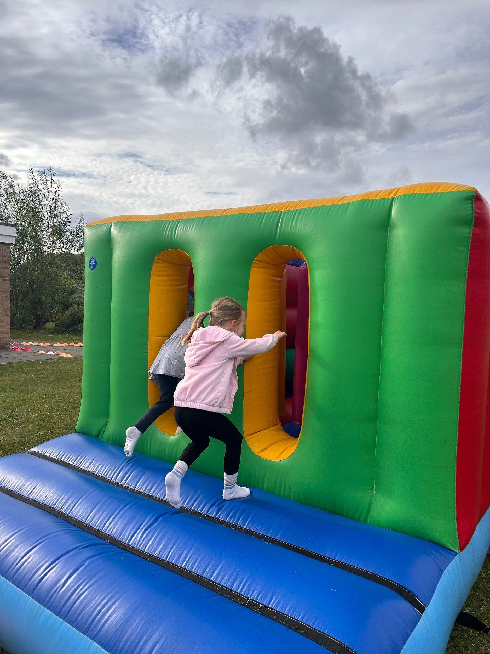
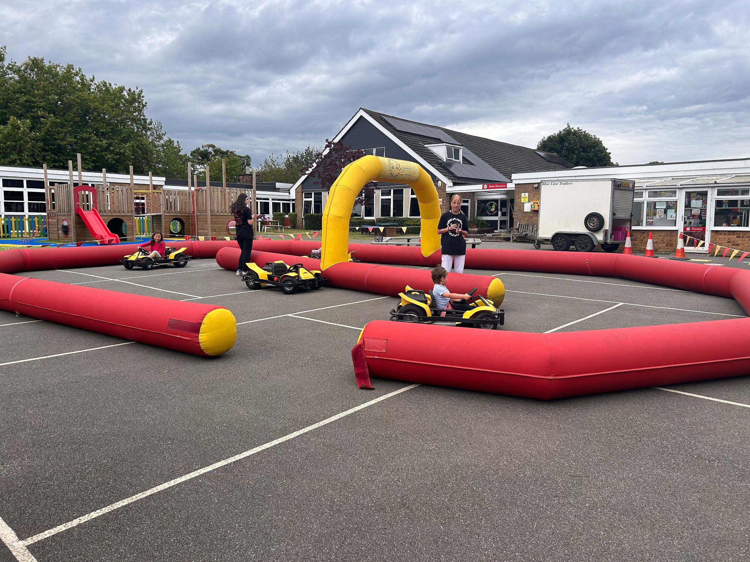
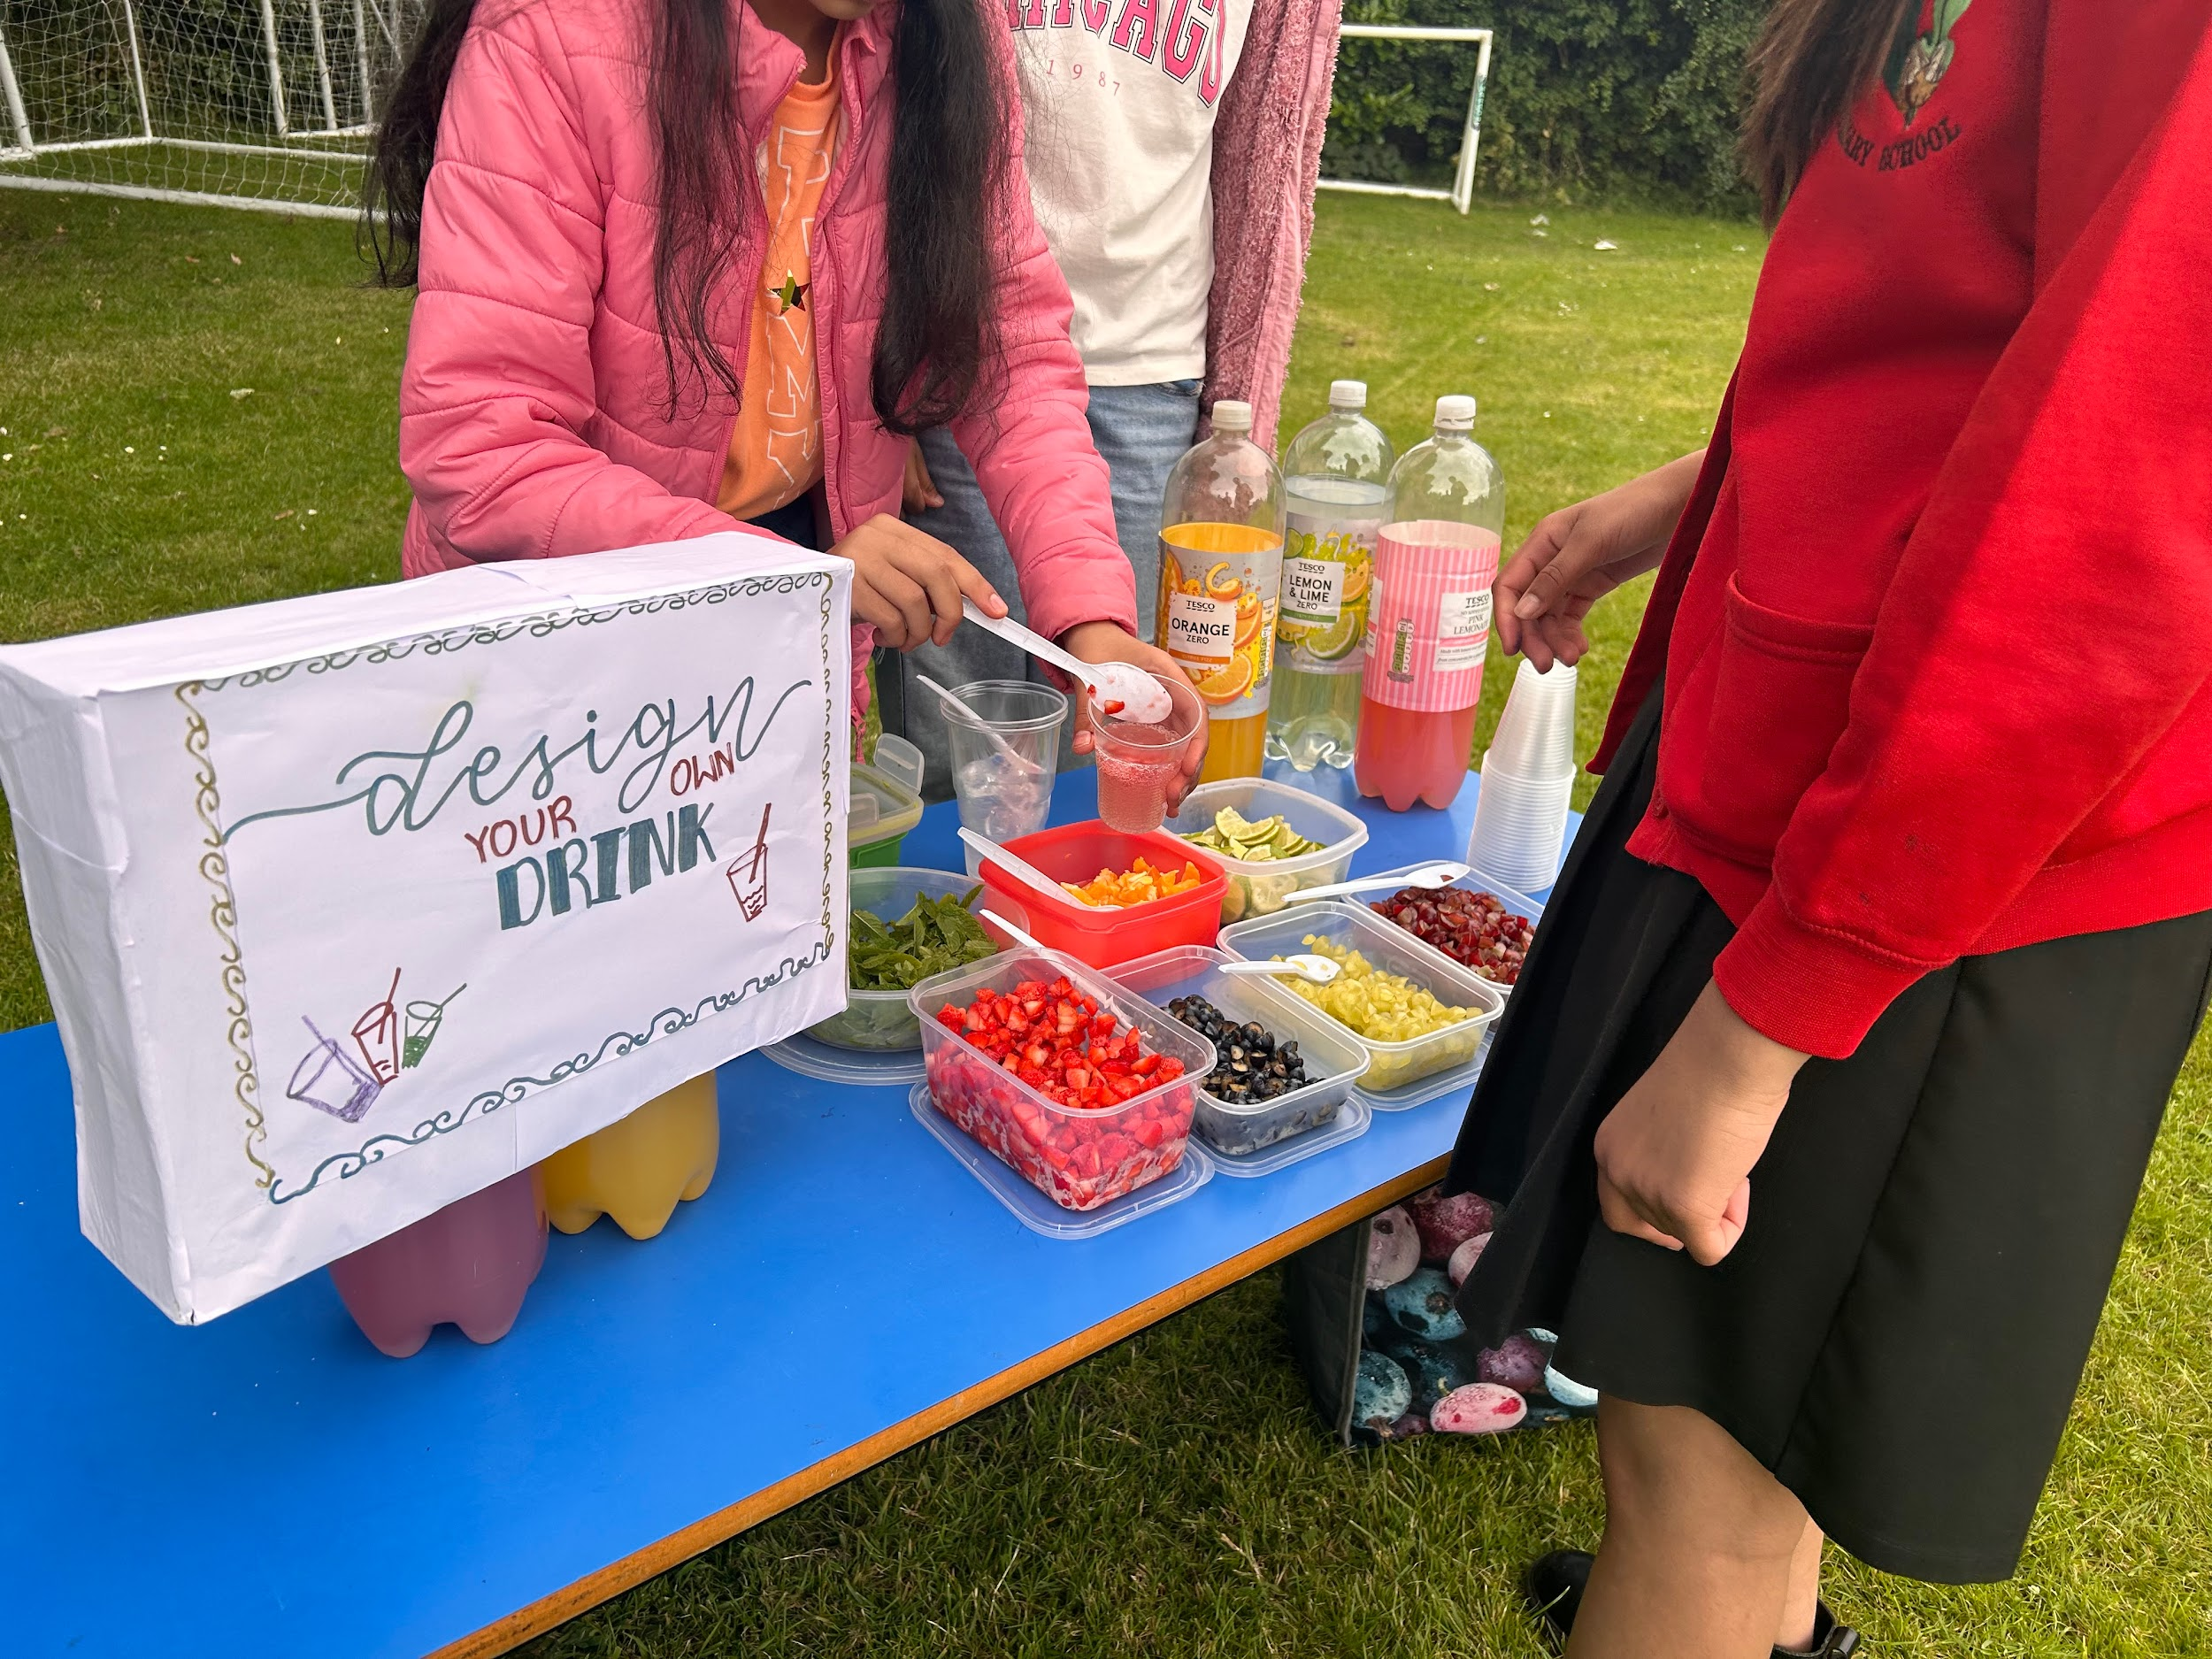
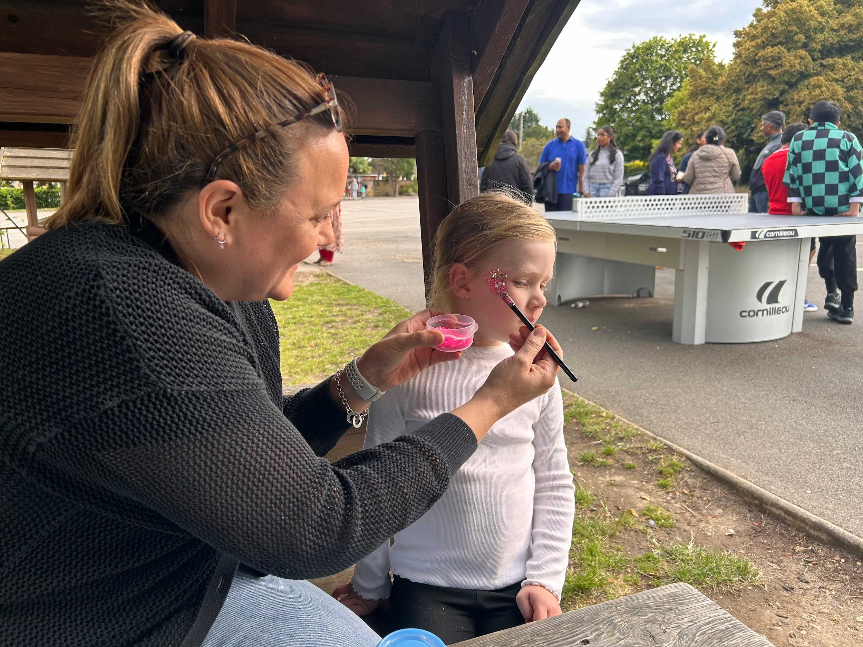
Summer Fair
Invited stall holders included C’wood book shop, Mathnasium, GelShot Games, Henna artist
PTA tuck stall, including 100 donuts donated by Wenzels
Stalls run by parents from each year group
Parents vs Teachers cricket game
Enterprise stalls by Y6 students
External food provider - Pallavi’s Kitchen
Held after school on a Friday in July
£2031
(£2,188 in 2022/23)

Slide 10
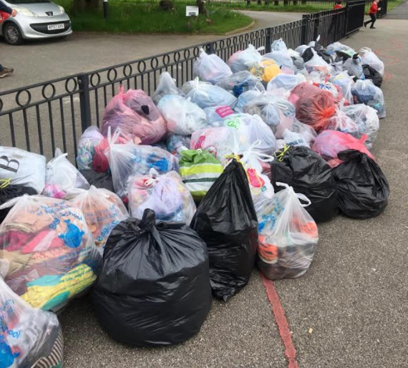
Bags 2 School
£256
(£528 in 2022/2023)
Recycle, reuse and reduce for a circular economy!
Our bi-annual donations of unwanted clothing, shoes, linen, towels, accessories etc. benefit those who need them most.
Payment lower as we had fewer collections

Slide 11
Second-hand
Uniform sale
Recycle, reuse and reduce for a circular economy!
Parents drop off, PTA members sort, then we sell!
£130
(£222 in 2022/2023)

Slide 12
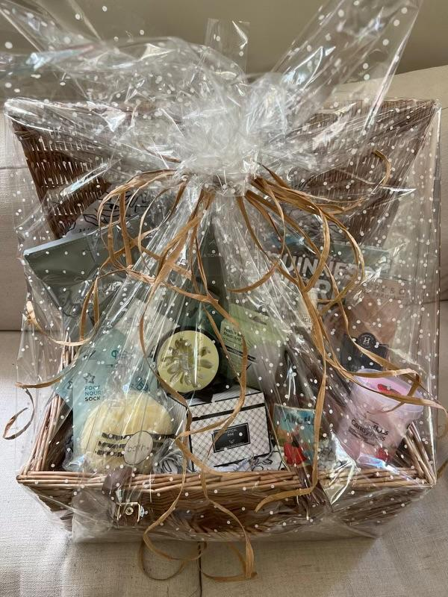
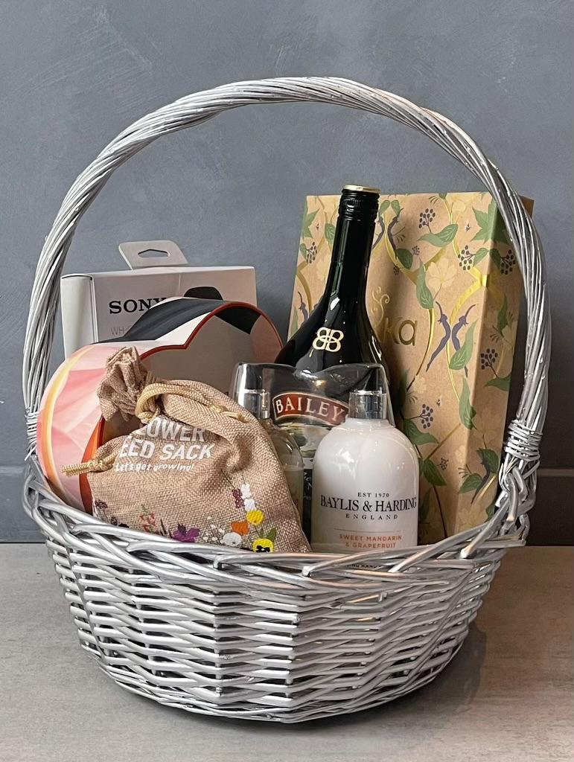
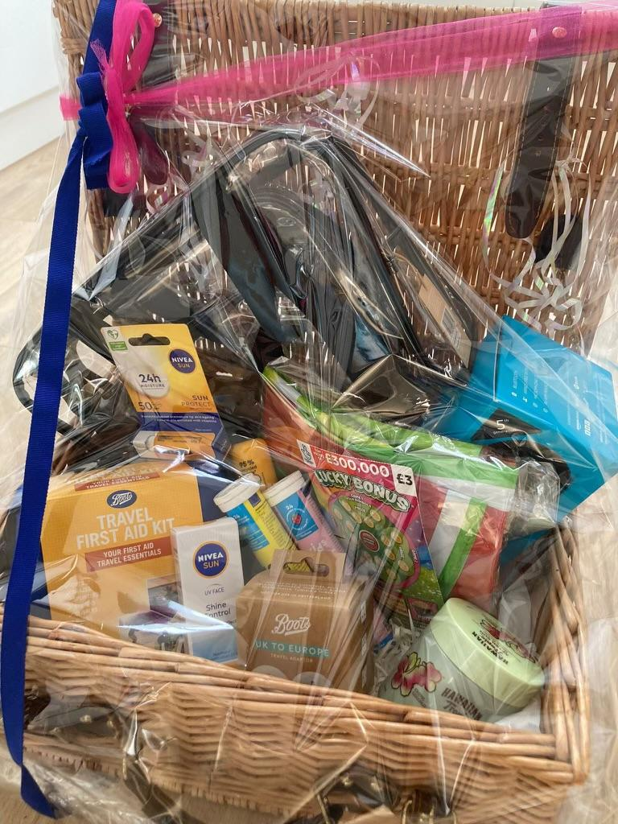
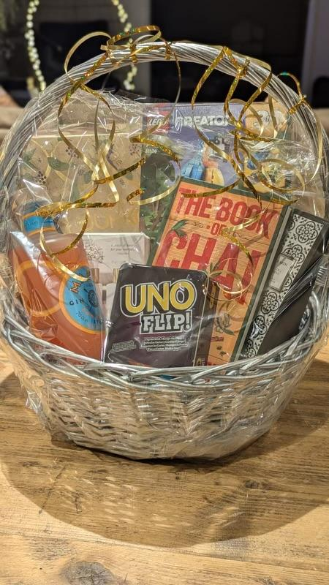
Christmas & Summer Hamper Raffle
Class reps collect money from parents at the start of each year to create two raffle hampers per year
Use ‘rally up’ to sell tickets and draw the raffle at the end of the Autumn and Summer terms
£1184
(Xmas)
£838 (Summer)

Slide 13

Commission/other
£638
(£732 in 2022/23)
Third-party providers to school at key moments across the year
Sports Day photos/ice cream and coffee vans/Xmas tree farm prize and plant sale
Includes: school lottery monies donated back to school
Photobox revenue lower than previous years due to format of sports day

Slide 14

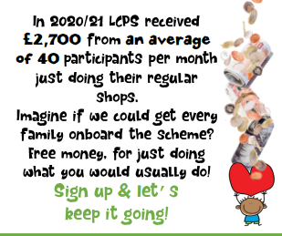



Shop til’ you drop!
Gift cards and Easyfundraising
£3,097
(£4,692 in 2022/23)
= 4%
= 4%
= 4%
= 4%

Slide 15



Matched Funding
£1,879
(£4,750 in 2022/2023)
(£4,874 in 2021/22)
Many companies will help charities through a matched funding scheme.
Could yours?
Some will match pound for pound, others will even double match fundraising.
Please ask your payroll or HR department if they participate in this scheme, it could make a significant difference!

Slide 16


Slide 17
Treasurer’s Report

Slide 18
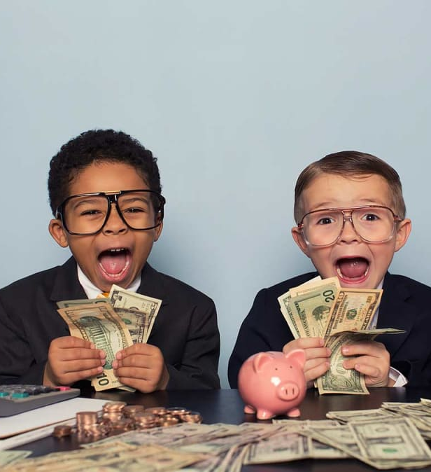
Where have LCPS spent our funds?
Here is how your contributions have helped to shape the school environment you see around you today….

Slide 19
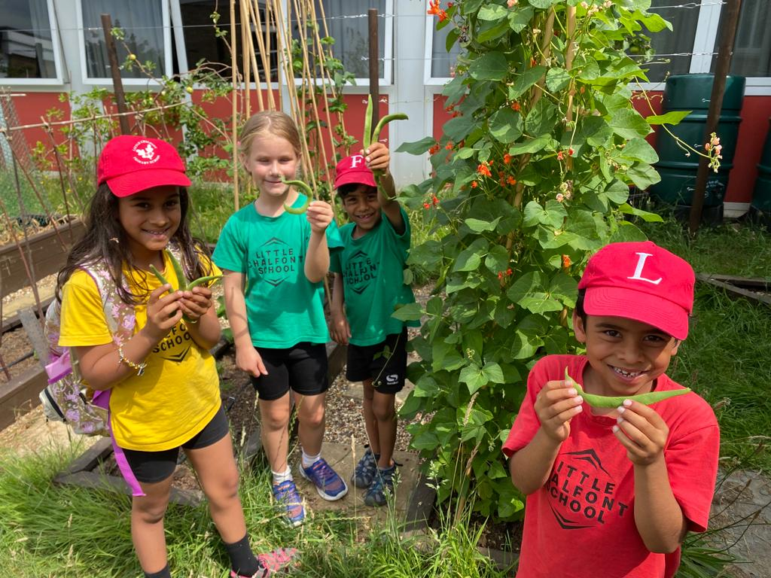
Last academic year
£22,750 (excluding amounts relating to prior year)
Of which £4,500 was investment items
In 23/24 the PTA raised c.£17,500 through events and initiatives
Leavers’ do = £220
Learning resources =
£932
Music lessons/
assemblies
=£7,060
White boards =
£3,008
Table tennis table
= £989
Sports kit for teams
= £442
Edible Garden = £10,300

Slide 20
Committed funds for 2024/25
Learning resources - £900
TTRockstars,
Lingoscope,
Libresoft
First News
Class music lessons and assemblies
Bucks Music £1,300
Rock and Pop £5,800
TOTAL = £8,900

Slide 21
And over 11 years…
Information Technology
Main hall AV system & ladder for access
Whiteboards
Gooseberry Planet online safety
Digital cameras & memory cards
Class set laptops
Class set ipads & cases
Charging trolley & USB leads
Class set Chromebooks & management console
Headphones
Interactive whiteboards
Digital leaders
Kidblog
NowPressPlay
Nursery & Reception (EYFS)
Outdoor play area, play equipment & artificial grass
Class set phonics books
DT teacher
Playground
New KS1 playground
Stage & chalkboard
Picnic benches & parasols
Memorial bench
Buddy bench
Play tunnel
Scooter/bike rack
Hulahoops, stilts, stompabouts, flexiweights
Playground survey & masterplan
Climbing frame refurbishment
Playbark, resurfacing trim trail
Powerwash & pressure washer
Timber treatment for play huts
Landscaping tools & safety equipment
KS1
Classroom chairs
Water play equipment
KS2
Classroom chairs
Classroom tables
Maths books
Yearly leavers celebrations
Drone workshops
Infrastructure
New dining hall chairs
Modular stage for the hall
Sports
Safety crash mat & gym mats
Football kits
Foam vault horse
Balance bench
Goal posts

Slide 22
And over 11 years…
Outdoor learning
Wheelbarrow
Compost
Plants & bulbs
Apple trees
Chicken coop & welfare
Maintenance & equipment
Gardening tools
Literacy
Phonics Bugs
Children’s newspapers & comics
Main Hall
Chairs
AV equipment
Music
Violin lessons
Dundun drums
Drum kit
Music software
Science
Rising Stars Science curriculum
British Science Week resources
Maths
Classroom teaching aids
Times Tables Rockstars
Cookery
Kitchen utensils
Ovens, hobs, microwave
Blender
Lab stools
Kitchen deep cleaning
Other
SEN resources
Lego for lego club
Art show funding
Year 6 leavers

Slide 23
Head Teacher’s Report
Support
Events
Newsletters
Get involved!
ALL FUNDS RAISED SPENT DIRECTLY ON ENRICHMENT OF YOUR CHILDREN!

Slide 24





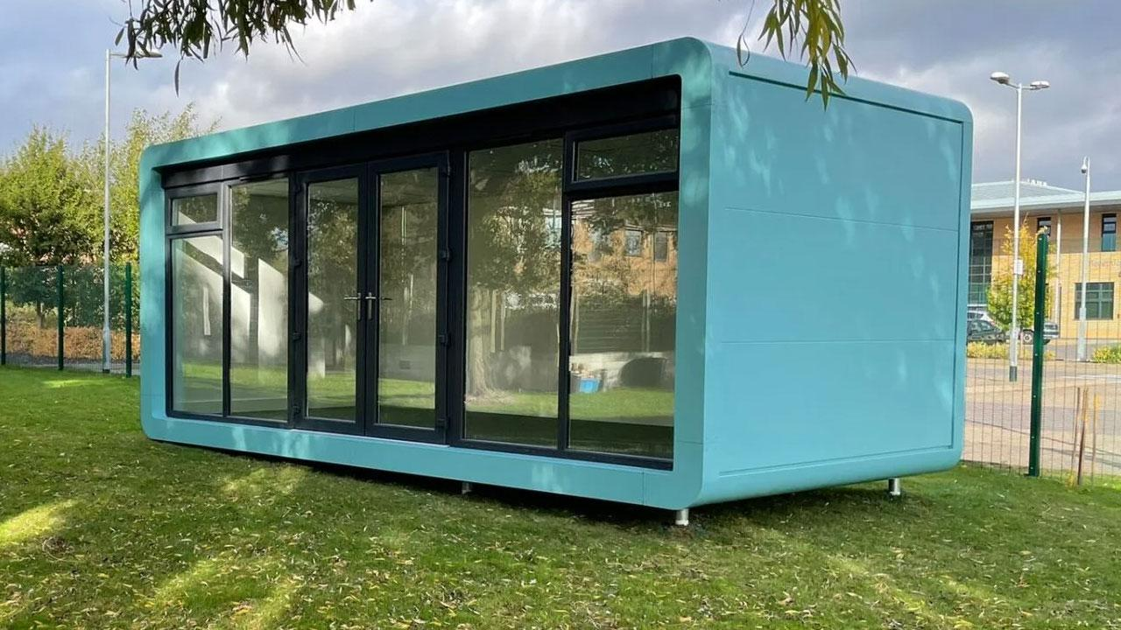
KS2 music lessons (4 different musical instruments)
Continuation of renewals for interactive resources in class
Edible garden teaching 1 day per week
Smartpod for music lessons and radio shows / podcasts to parents
SEND resources
“Now, press, play” subscription
Head Head Boy and Girl have requested further magazine subscriptions for Years 5 and 6

Slide 25
Elections
(Committee Members, Officers, Auditor)

Slide 26

Retiring members:
A big thank you to:
Monica Gill (outgoing Secretary)
Jasneet Ladd
Himanshi Mody (outgoing Chair)
Utkarsh Kadganche
Marcos Sebastian
Maria

Slide 27
Re-election of current members:
A continued thank you to:
Emma Evans (Chair)- Vote
Rob Hacking
Colleen Byrne
Whitney Hall (Vice Chair) - Vote
Ivan Mera
Solomon Kamal-Uddin
Caroline Lennard (Continue as Treasurer)
Bijal Pankhania (Secretary) - Vote
Kate Ross
Myfanwy Beynon will continue as our Auditor.

Slide 28

Election of new parent and teacher members (Vote):
Geeta Ruparelia
Jyoti Ghai
Mrs West
Mrs Malton
Thank you for joining our committee!
New joiner form to be completed and your details will be added to the Charity Commission and school website in due course.

Slide 29
AOB & Open Questions

