Slide 1
Anti-Bullying approach
LCPS
Mr Hacking

Slide 2
Why is this approach needed?
Pupil survey from the School Council in the autumn term (2022) identified concerns around bullying from some pupils across the school.
Parent survey in the autumn term (2022) echoed the pupil survey.
Anti-Bullying Alliance audit – completed in autumn – identified several areas where we could be better.
We’ve committed to completing the United Against Bullying (UAB) Programme.

Slide 3
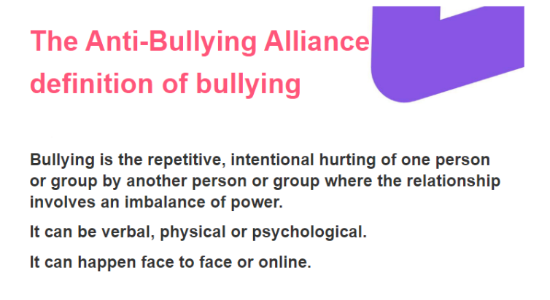
What is the ABA definition of bullying?

Slide 4
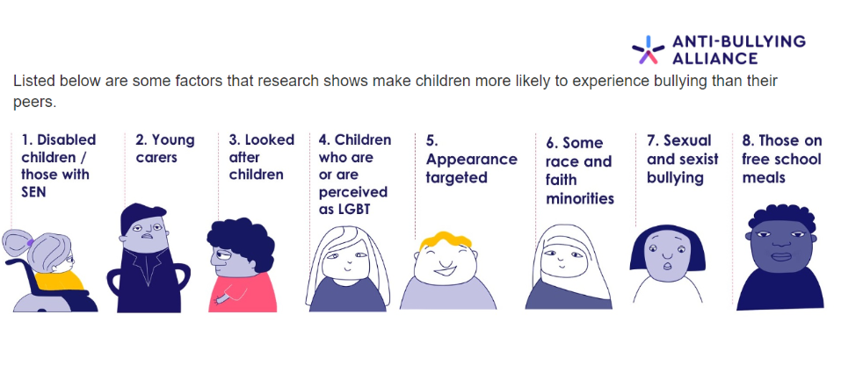
Some groups may be more at risk of bullying:

Slide 5
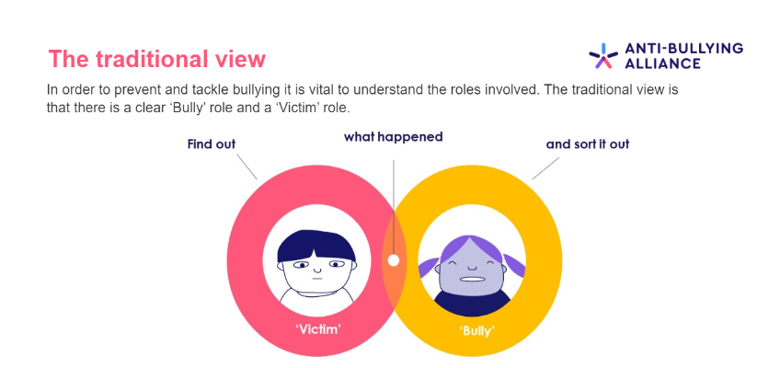
The traditional view of what bullying is:

Slide 6
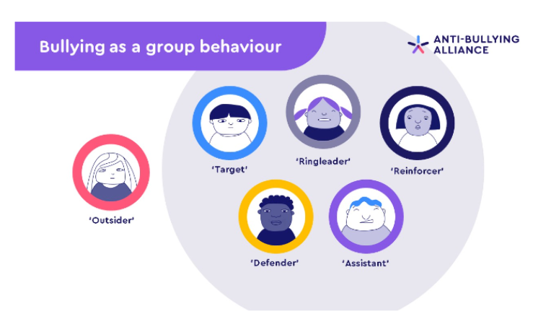
What bullying is in reality:

Slide 7
What we want:
We encourage all children to be “defenders” in bullying situations…
Every incident we deal with, we can categorise the children into one of those roles.
Standing watching someone being bullied and doing nothing means you are part of the problem and are involved in the incident.

Slide 8
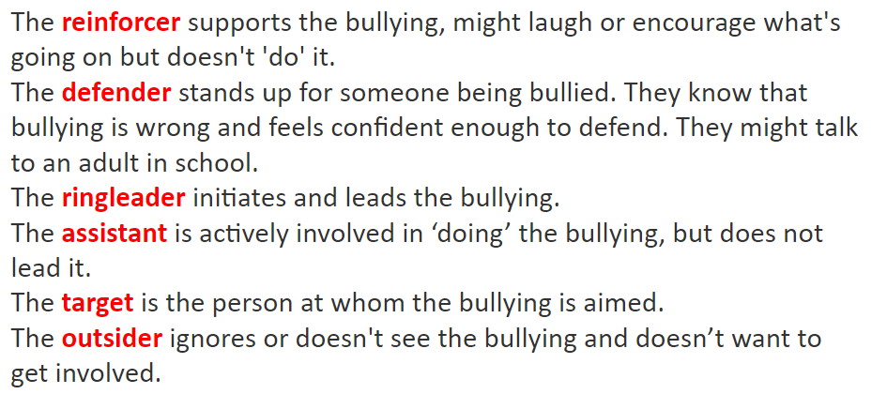
In reality…

Slide 9
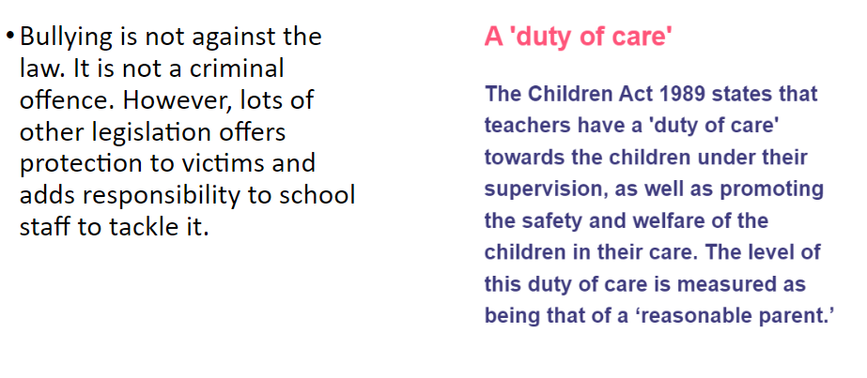
Is bullying against the law?

Slide 10
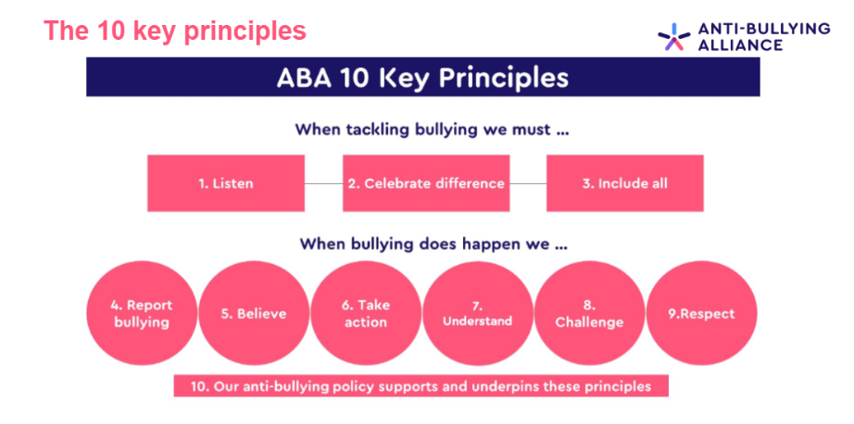
Our approach when bullying has been identified:

Slide 11

Passing bullying off as “banter”
If words or actions make somebody feel negative and it is repetitive, it IS bullying

Slide 12
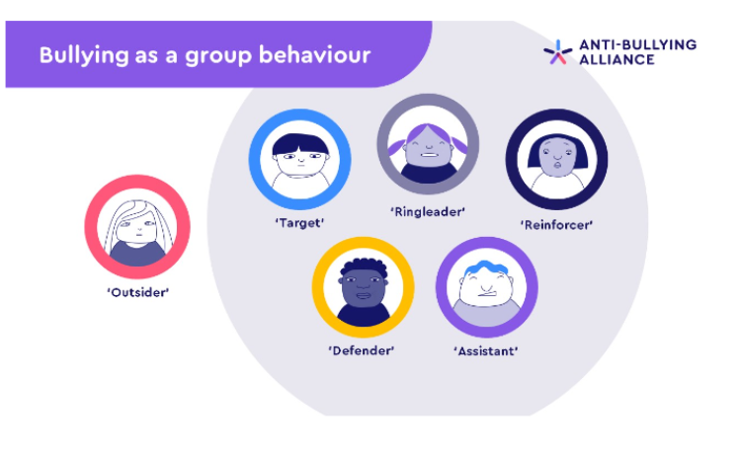
What can parents do at home?
Listen in a non judgemental / non-emotive way
Take what is said seriously
Speak to school
Use the following labels to explain the incident

