Slide 1

LCPS Hometask Challenge #1
Results
In celebration of VE Day on Friday (8th May), this week’s hometask challenge was to recreate an historical moment.
We received a plethora of magnificent recreations and we have attempted to select some of the best of a superb bunch.
Thank you for your incredible entries. The next hometask challenge will be posted onto each google classroom on Friday at 3.30pm. Best of luck!

Slide 2
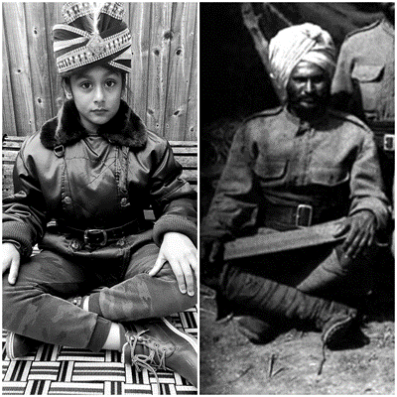
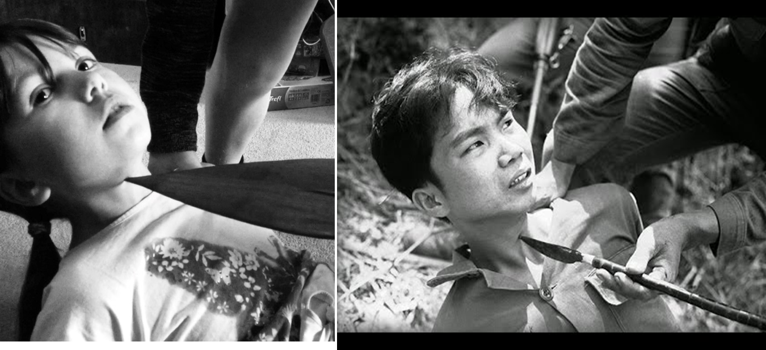
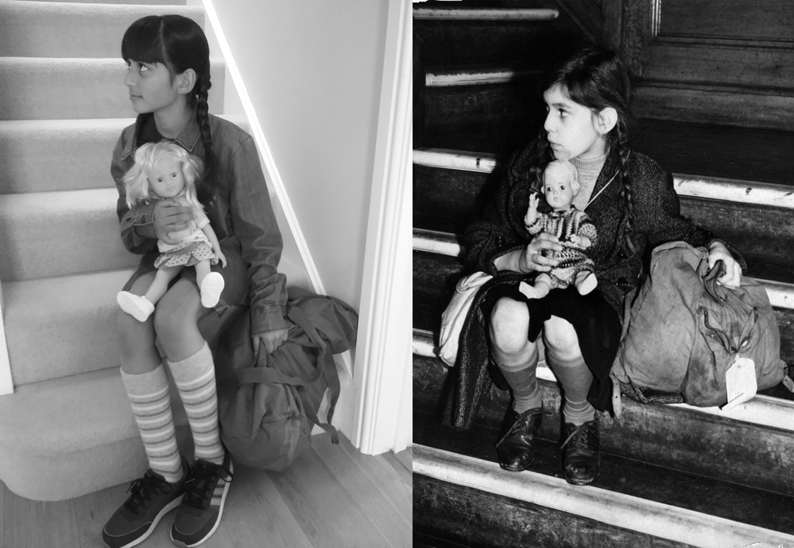
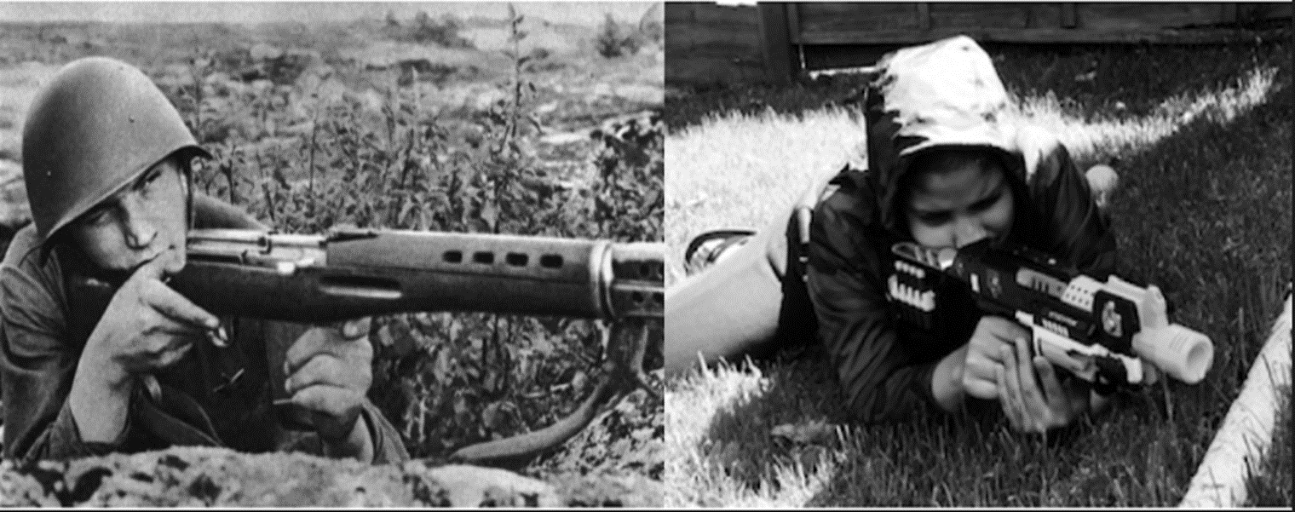
Here are some close contenders!

Slide 3
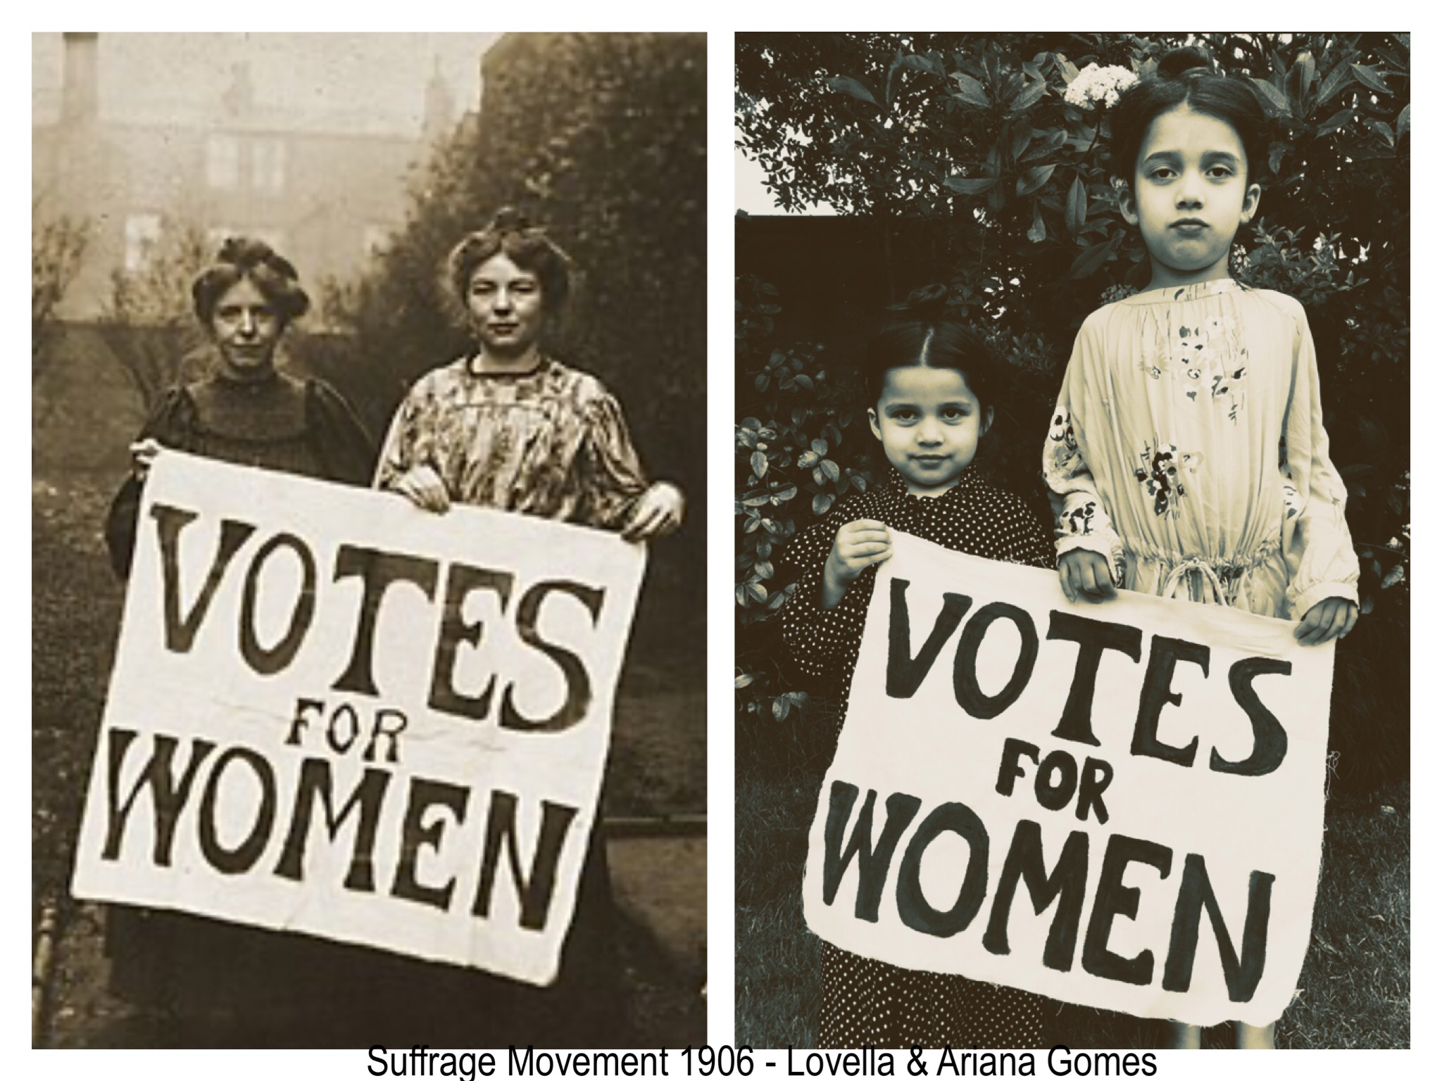
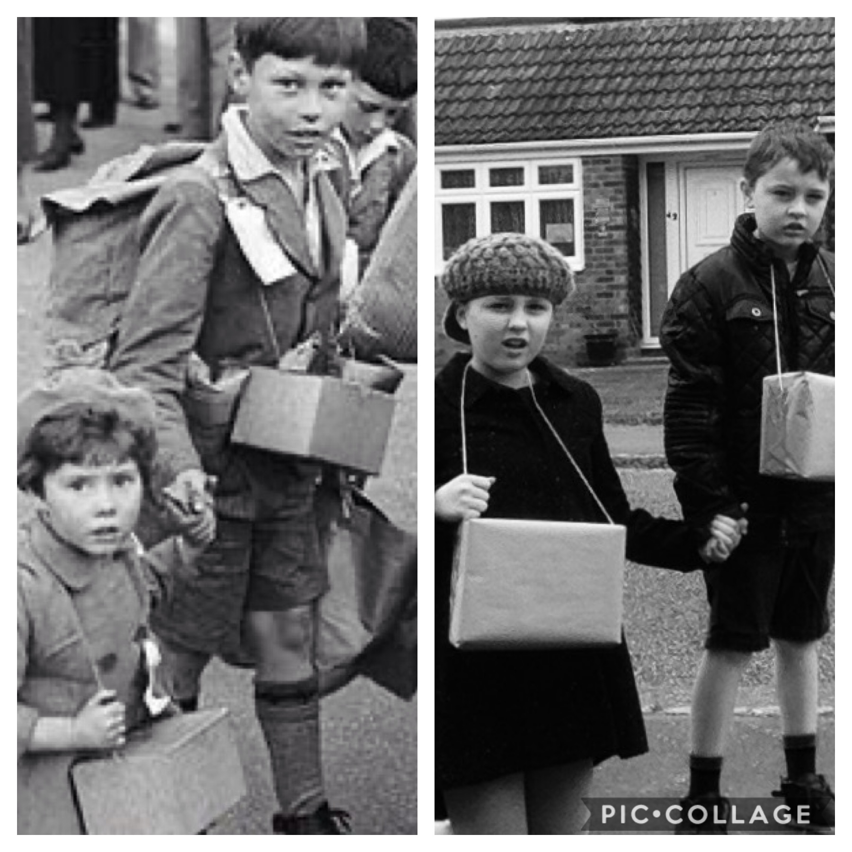
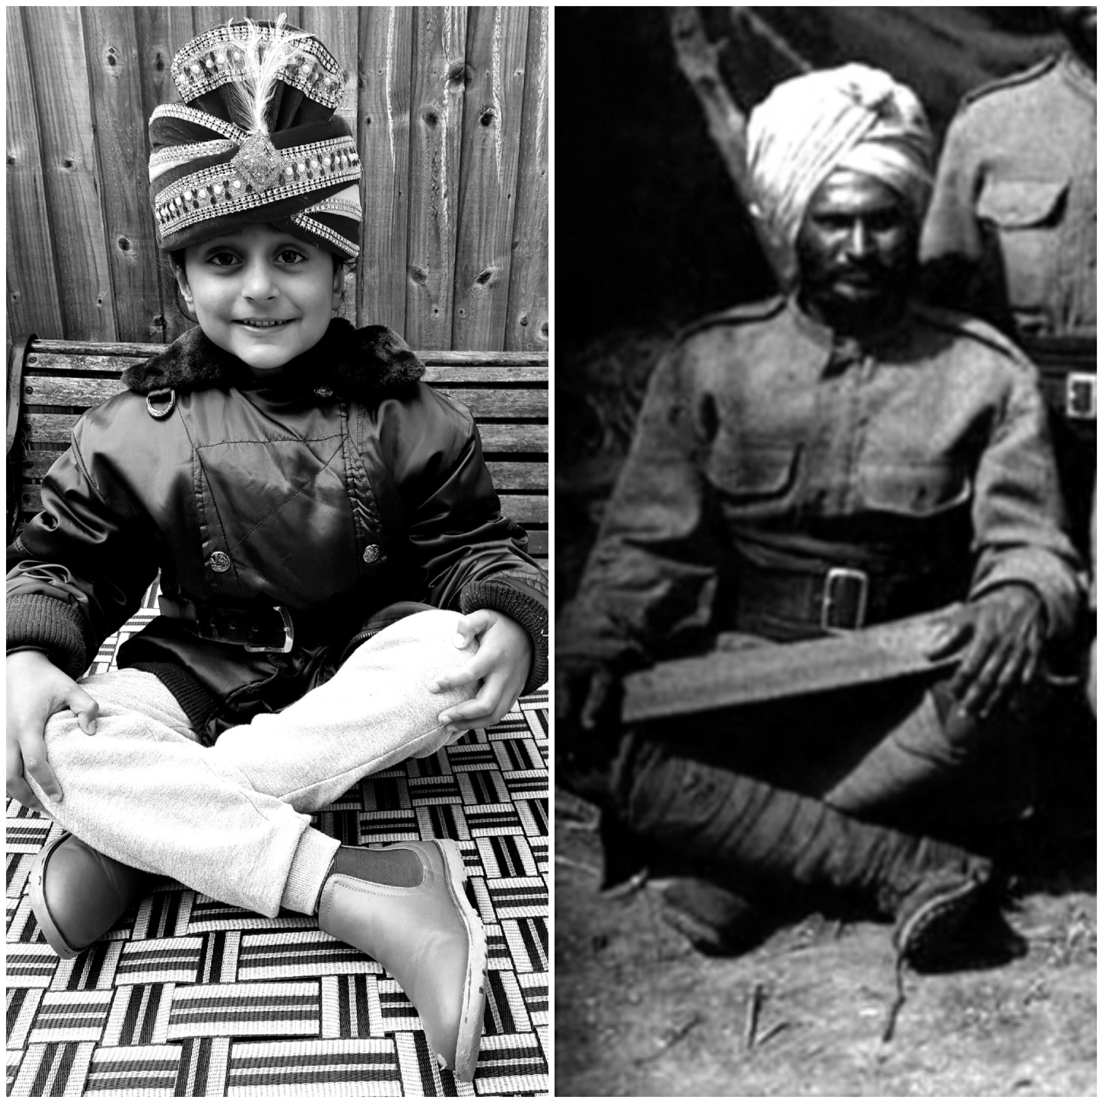
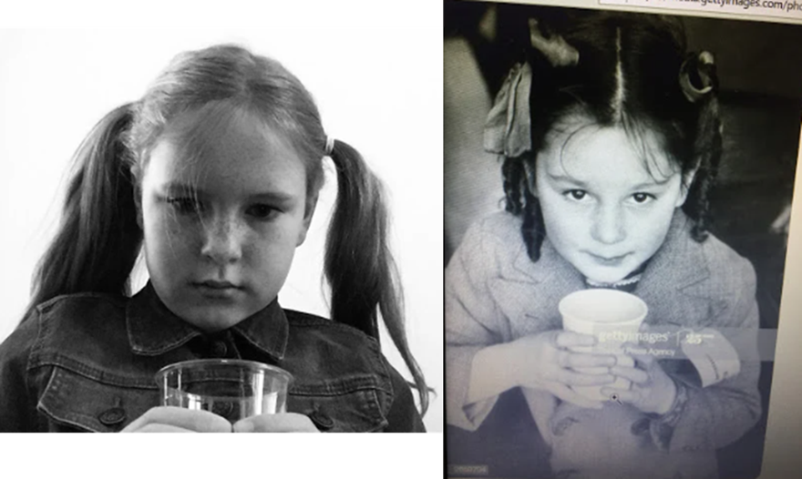
And a few more…

Slide 4
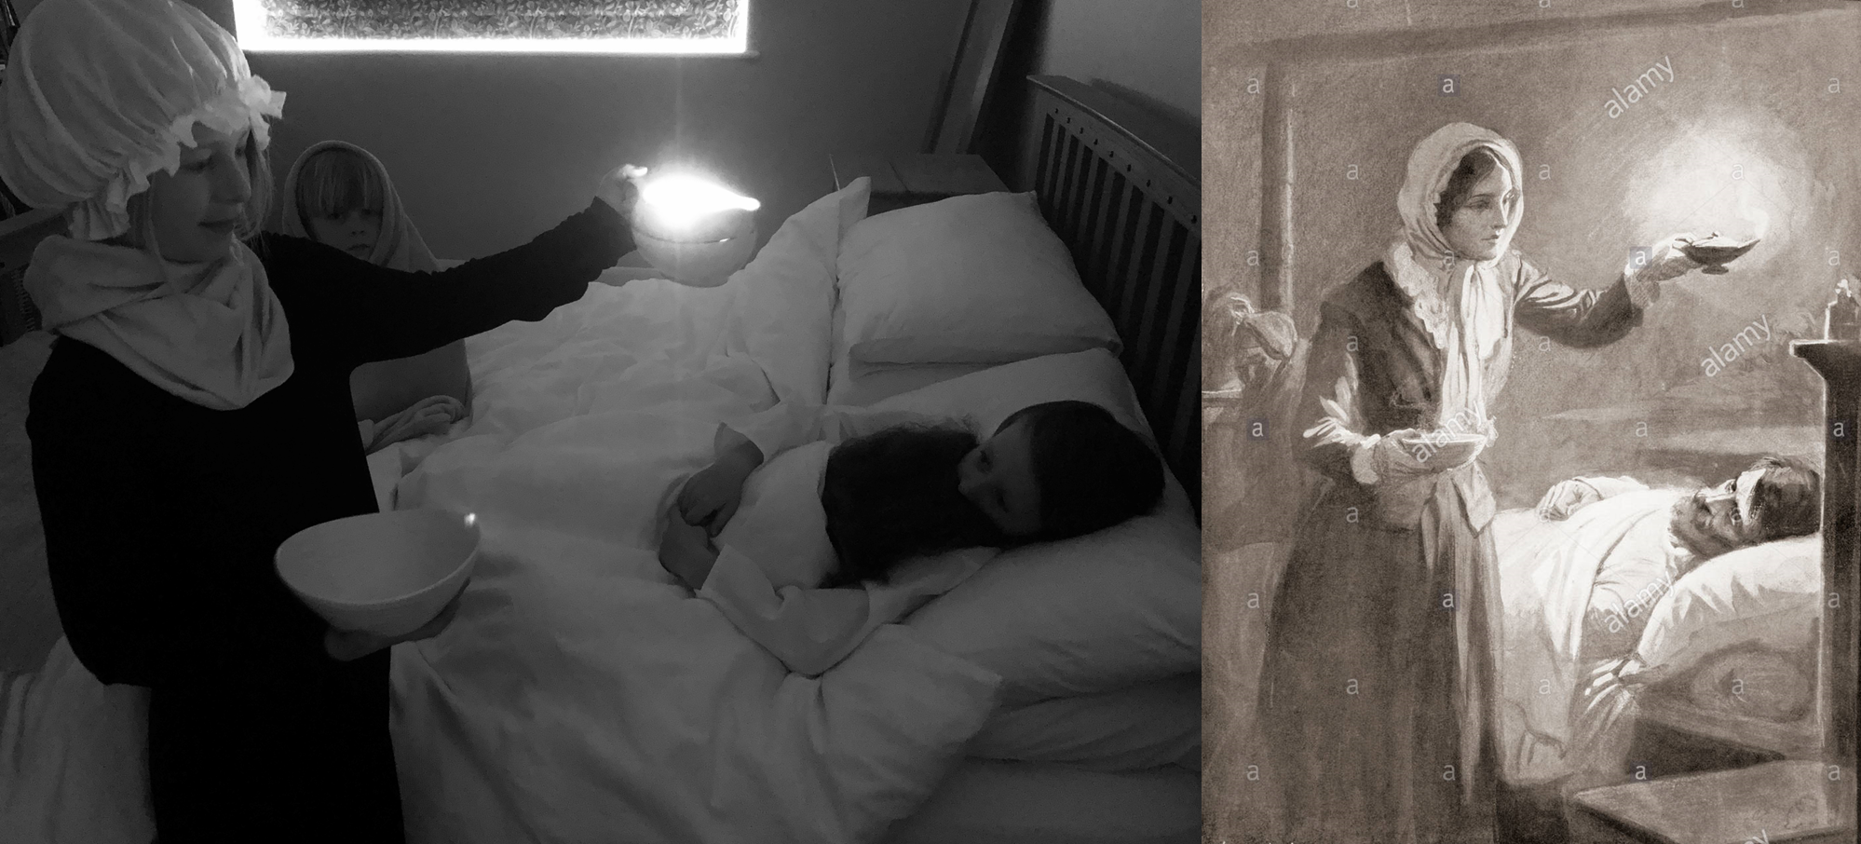
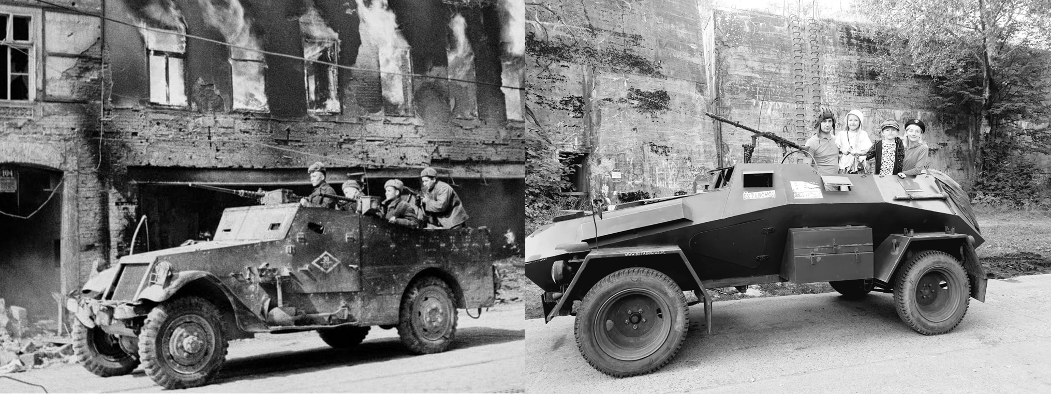
The runners up are the Crabb and Wojcik families!

Slide 5
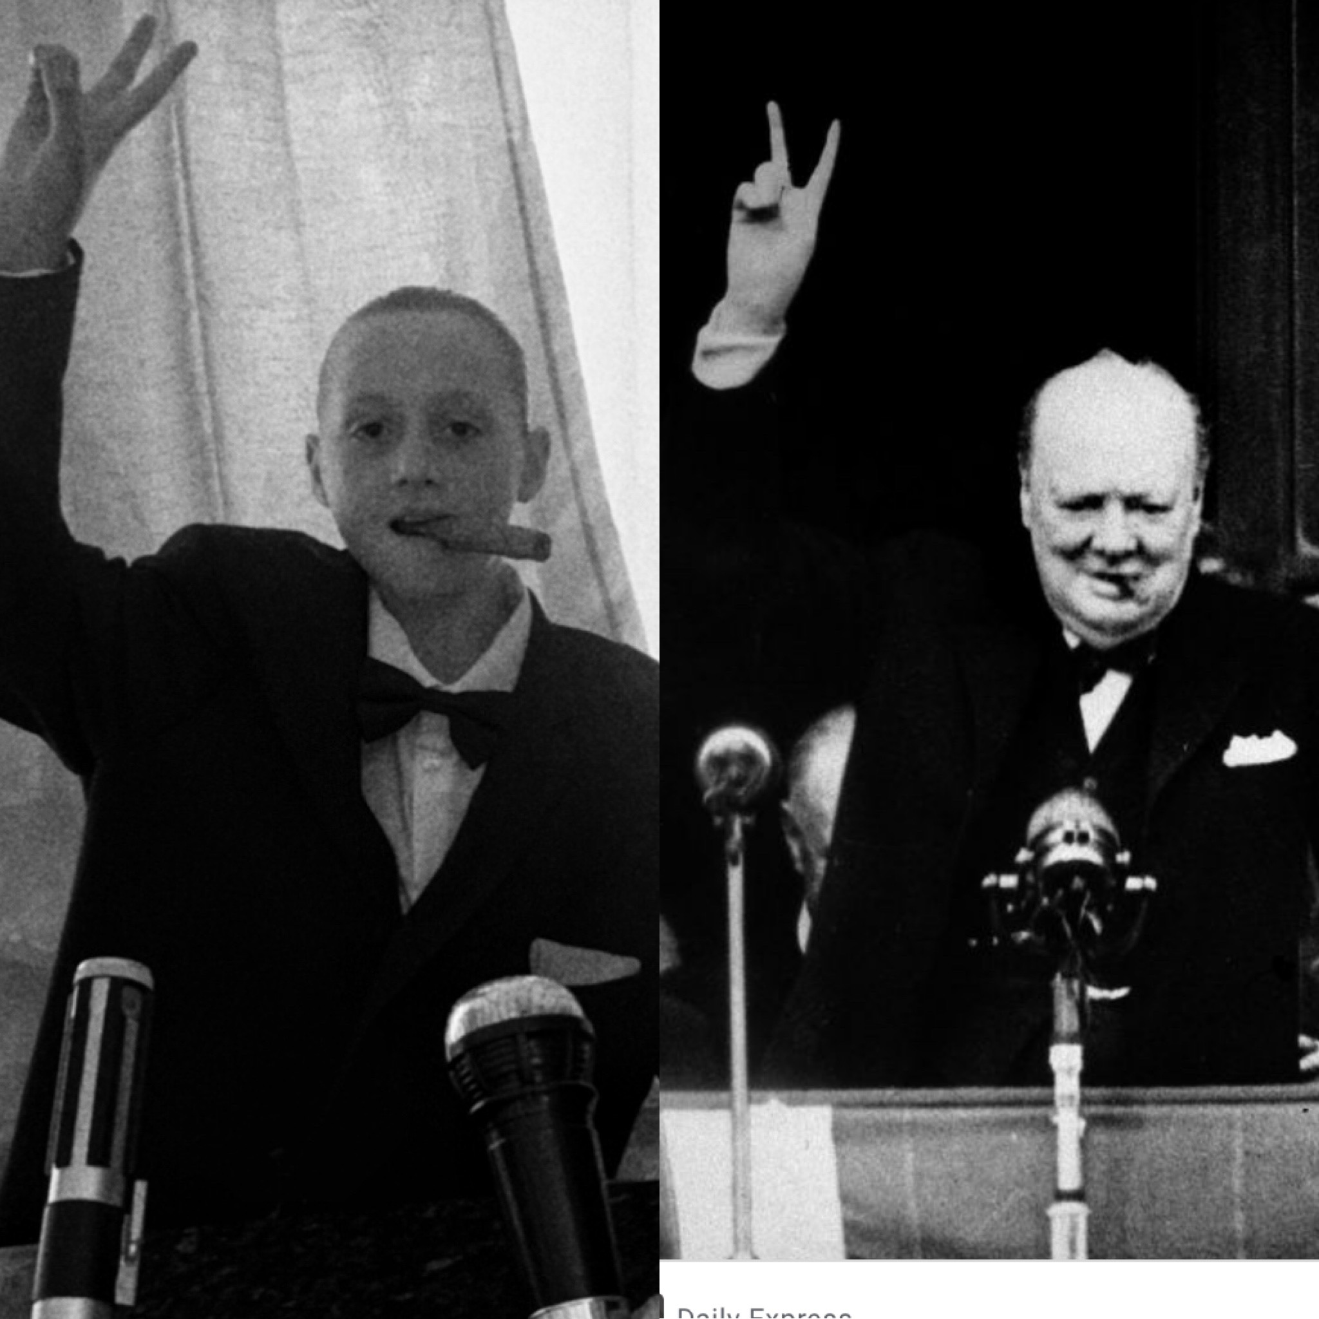
The winner is Ellie-May in year six!
Ellie-May, your unwrapped air guitar should have arrived this morning!

